Slide 1
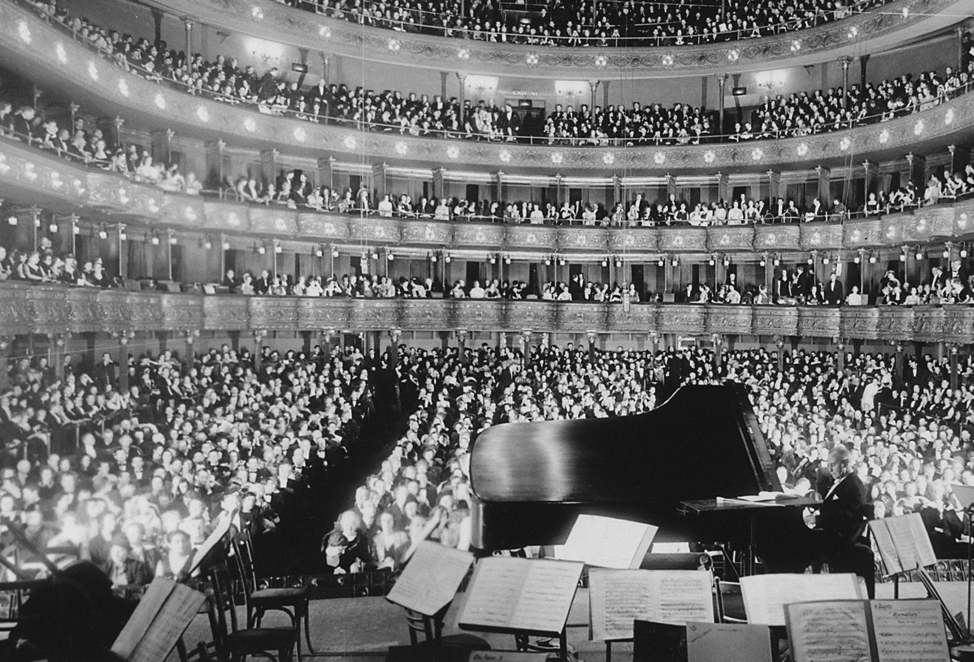
ApplauSim: A Simulation of Synchronous Applause
Andi Horni, Lara Montini, IVT, ETH Zürich

Slide 2
Motivation
Lecture Prof. Dr. Rainer Hegselmann, last 2 credit points
Create a parsimonious model vs. large-scale daily business
MATSim emergence

Slide 3
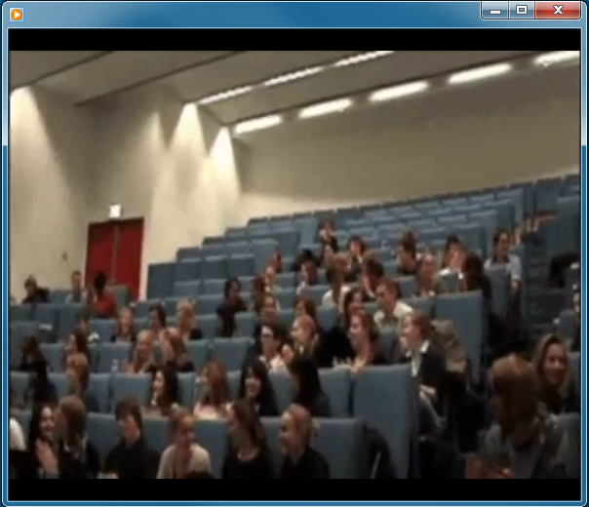
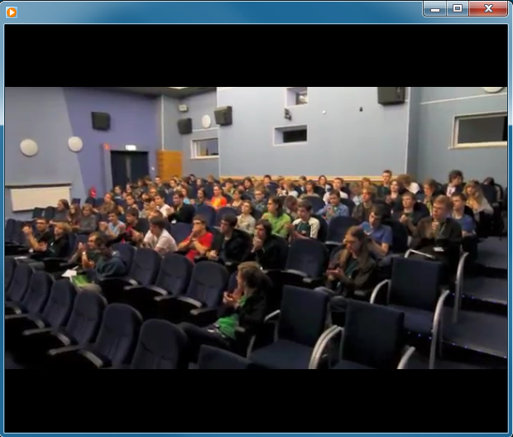

Slide 4
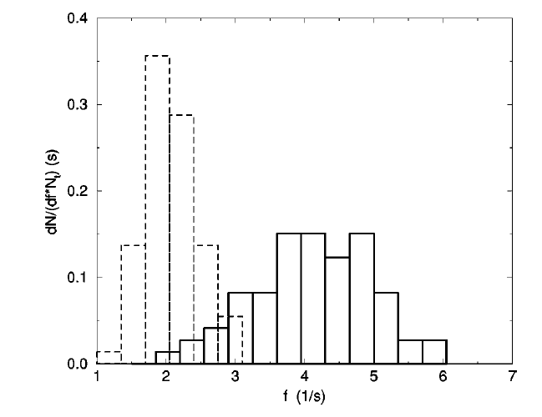
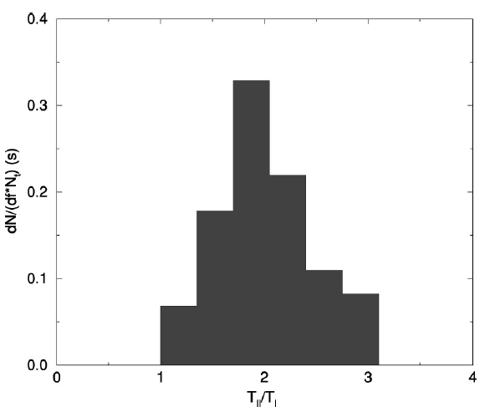
Synchronous Applause
Period doubling (frequency bisection)
73 persons
[Néda, Z., E. Ravasz, T. Vicsek, Y. Brechet and A.-L. Barabási (2000) Physics of the rhytmic applause, Physical Review E, 61 (6) 6987–6992]

Slide 5
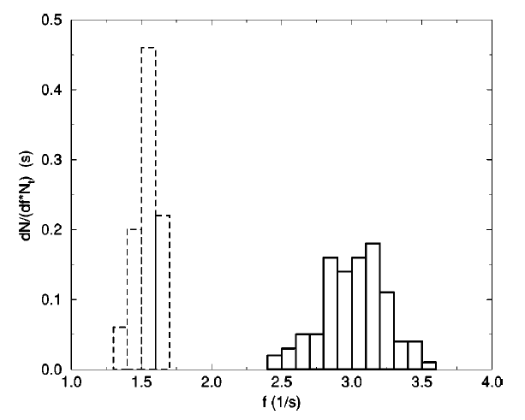
Synchronous Applause
The game is learned …
1 individual, 1 week
East vs. West-> videos

Slide 6
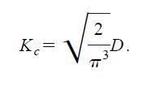
Synchronous Applause
Period doubling and frequency dispersion
[Y. Kuramoto and I. Nishikava, J. Stat. Phys. 49, 569 ~1987!.]
K_{C}: kritical coupling
D: oscillators’ natural frequencies dispersion
I: normal clapping
II: synchronous clapping

Slide 7
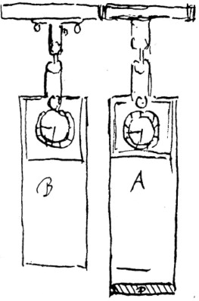
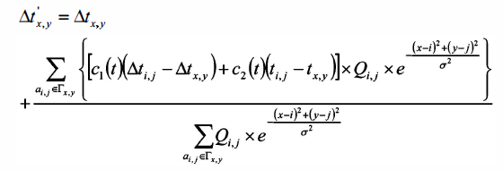
First Models
seminal paper Neda, Ravasz, Vicsek,Brechet, Barabási (2000)
Kuramoto and Nishikava (1987): globally coupled oscillators
applied to clapping
Li, Liu, Sun and Han (2009):

Slide 8
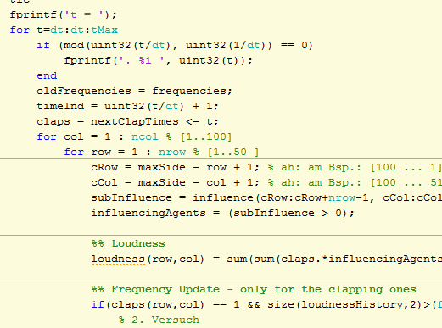
Type of Model
descriptive, explicative?
multi-agent but not in software structure
matrices! (LaHowara & Commander Spock)
MATLAB
SourceForge

Slide 9
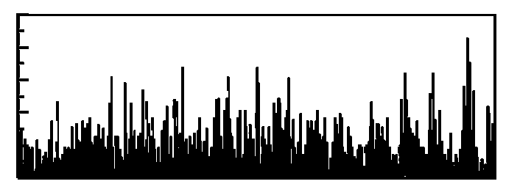
«Behavioral» Model
Kuramoto’s globally coupled oscillators
see also Xenides, Vlachos and Simones (2008):
C_{prio}, I_{prio}

Slide 10
From Peaks to a Rhythm - Exogeneity
f_{0,}φ₀
f_{1,}φ₁
Δt
exogeneity problem
searching for the “frequency band” with the highest regularity
different for every agent (errors, sound=f(distance)) band not pre-specified

Slide 11
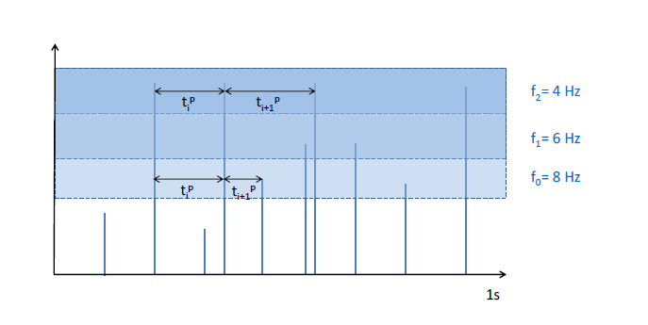
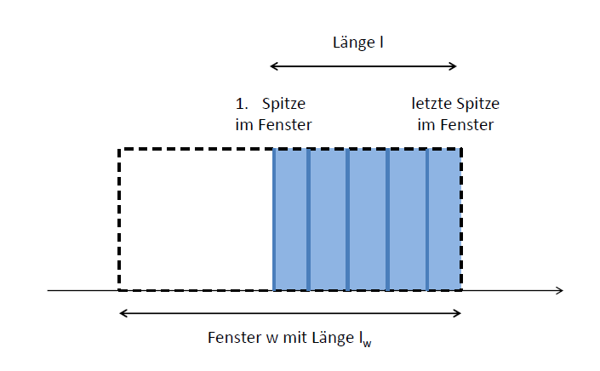
From Peaks (and Gaps) to a Rhythm – In More Detail
γ_{loudness}: average loudness in window
γ_{lenght} : boundaries of window --->
γ_{gap}: depth of gaps (listen to peaks and gaps)

Slide 12
From Peaks to a Rhythm: Adaptation
regimes for adaptation (categories in human perception and behavior)
χ_{new} = f(α,β,τ,λ) • g(χ_{current,} χ_{perceived} ) (χ = frequency, phase)
α
1.0
r_{w}
β = f(Δ(χ_{perceived}, χ_{current}))
= f(r_{max}(t-Δt)): decreasing with t
λ : phase stronger than frequency

Slide 13
Main Hypothesis
… period doubling why does this help
constant errors:
Τ_{target} = f(Τ_{perceived} + ε_{motor} )
with Τ_{perceived}= f(… + ε_{perception});
and ε  f(frequency)
experiments -> synchronizers

Slide 14
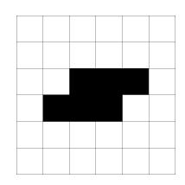
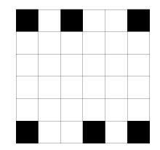
Results - Configurations
high frequencies (μ=4Hz, σ=1Hz)
6 synchronizers in the center
6 synchronizers at the fringe
variable number and distribution of synchr.
low frequencies (μ=2Hz, σ=0.5Hz)
6 synchronizers in the center
6 synchronizers at the fringe
variable number and distribution of synchr.
3. no synchronizers, low frequencies
4. no errors, high frequencies
30 runs each, 6 x 6 persons

Slide 15
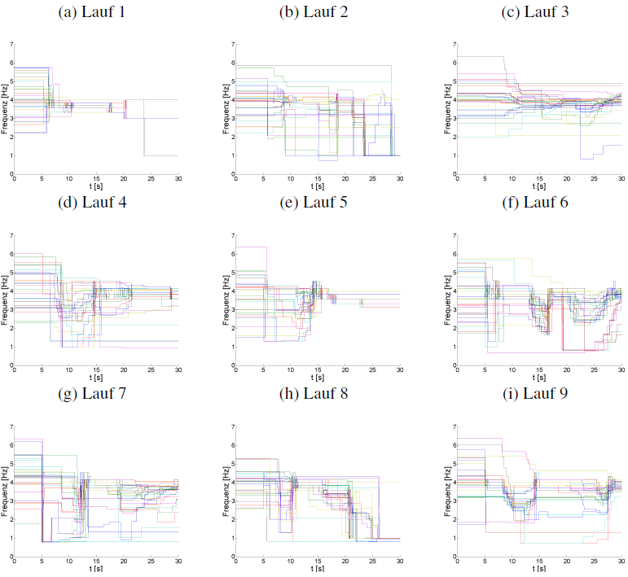
1.a
Notes:
Figures repr. Chosen
Saal Anordnung
WAV!

Slide 16
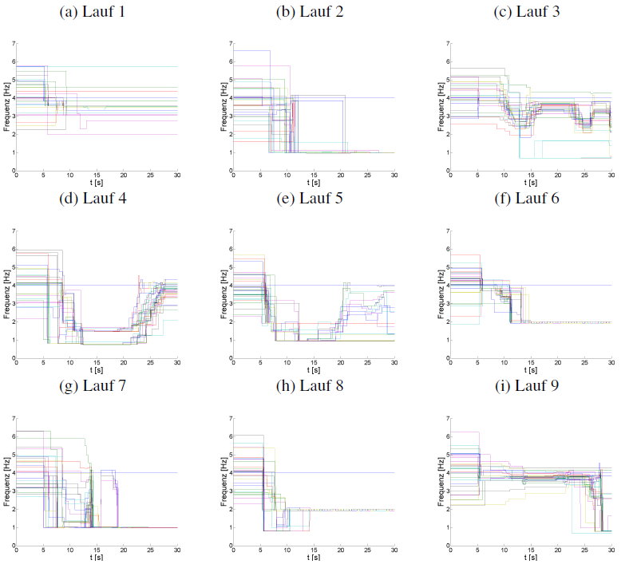
1.b

Slide 17
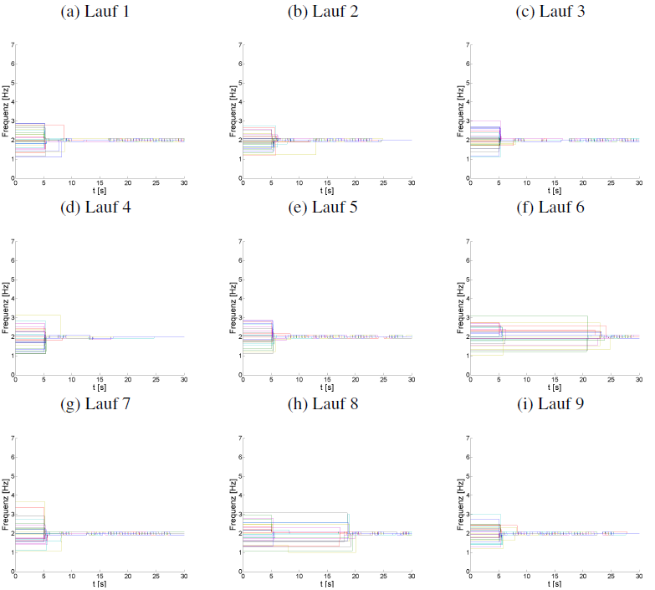
2.a

Slide 18
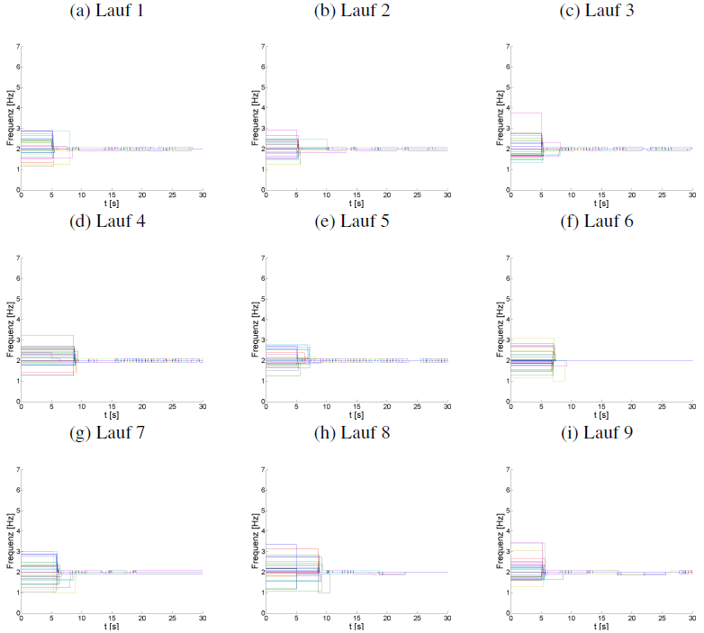
2.b

Slide 19
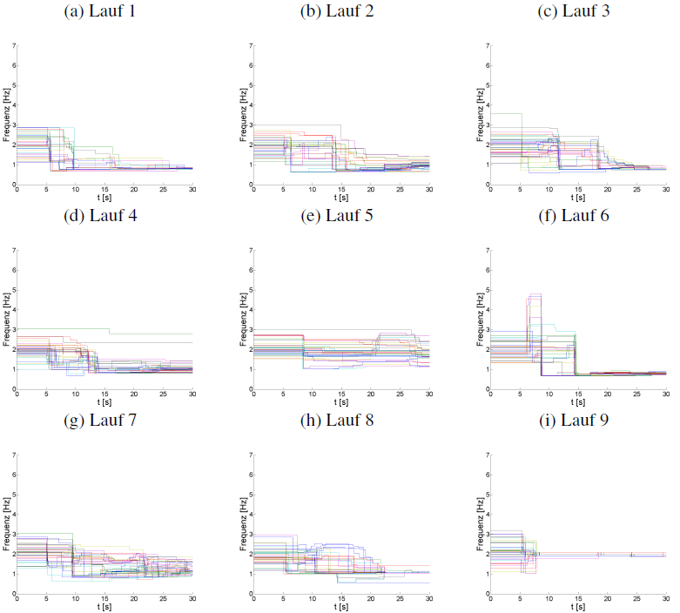
3

Slide 20
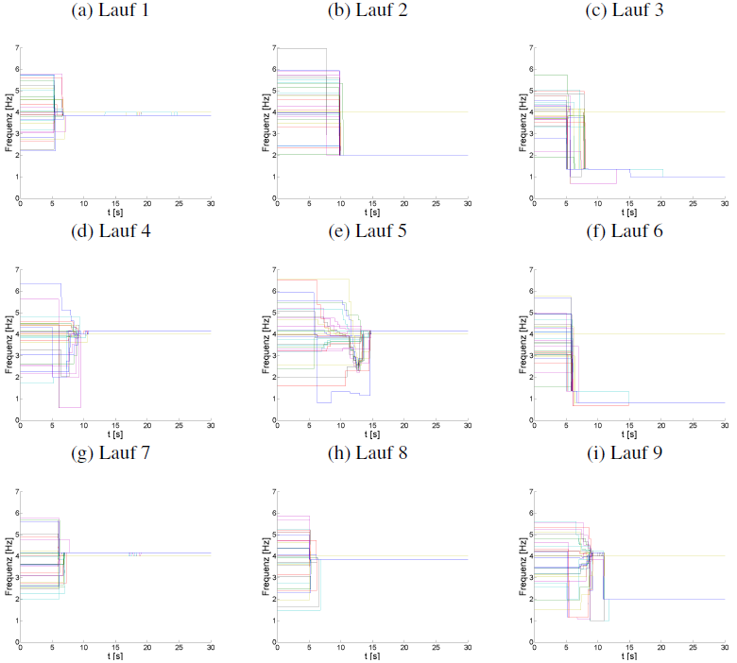
4

Slide 21
Conclusions
influence of errors
influence of synchronizers
phase synchronization problem
transition process f_{high} -> f_{low}
σ_{start frequencies}
general or temporal effect
heterogeneity of agents
excitement level (Xenides et al. 2008)
loudness
synchronization will

Slide 22
and now?
course points
playground: http://sourceforge.net/projects/applausim/
MATSim & emergence
“one of the most seductive buzzwords of complexity science” MacKay (2008, p.T274)
“when constructing agent systems, you should regard emergence as an important concept” … “you can try to “design in” the emergence that you want”. Odell (1998)
Functional form of MATSim queue-based network load simulation

Slide 23
Emergence and Non-Linearity
Superposition principle invalid
-> non-linear regimes
BPR function for traffic assignment:
β usually between 5 and 11
MATSim: multi-agent transport simulation
queue model for network load (link) simulation

Slide 24
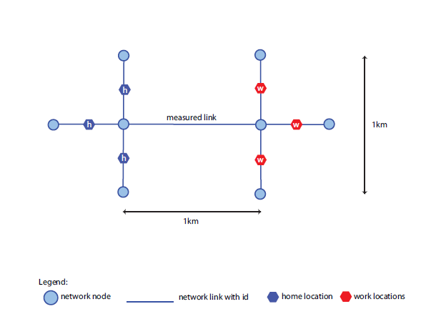
Evaluation of MATSim Network Load Simulation

Slide 25
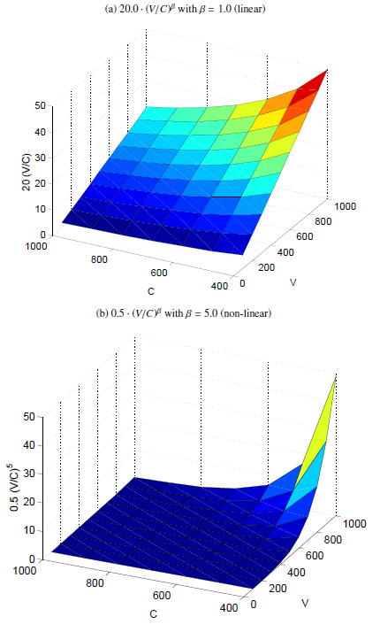
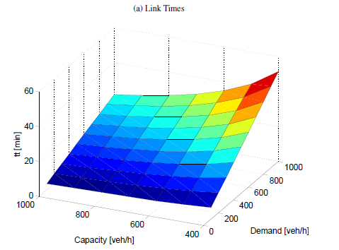
BPR
MATSim

Slide 26
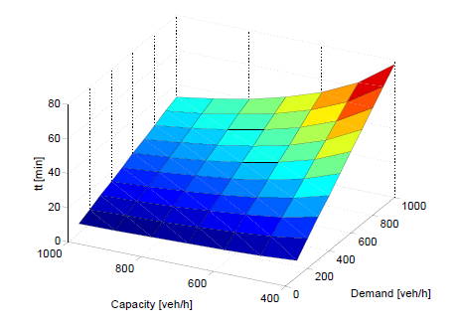
BPR
MATSim

Slide 27
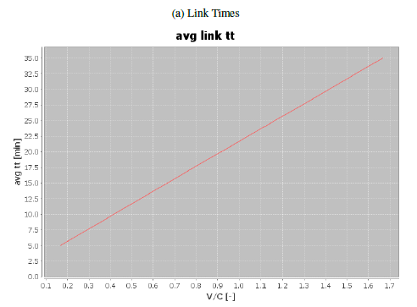
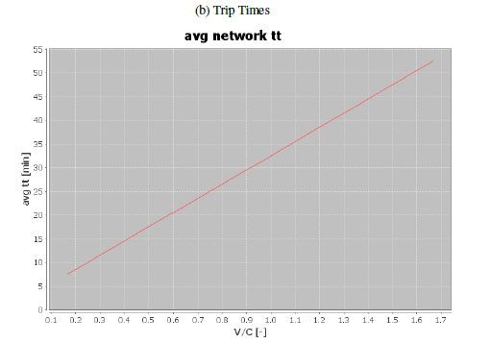
MATSim

Slide 28
Emergence and Non-Linearity
agent interactions
feedback
-> non-linear in nature (Goldstein 1999)

Slide 29
The End and Applause

