Slide 1
Bevorzugter Zitierstil für diesen Vortrag
Axhausen, K.W. (2012) Large-Scale Travel Data Sets and Route Choice Modeling: European Experience, presentation at Workshop 189 „Route choice modeling and availability of data sets“, 92nd Annual Meeting of the Transportation Research Board, Washington, January 2013.

Slide 2


Large-Scale Travel Data Sets and Route Choice Modeling: European Experience
KW Axhausen
IVT
ETH
Zürich
January 2013

Slide 3
Acknowledgements
GPS surveys and analysis:
  Nadine Rieser – Schüssler
  Lara Montini
Mikrozensus 2010 (Swiss national travel diaries survey)
  Matthias Kowald, ARE (Federal Office for Spatial Development), Bern
  Kathrin Rebmann, BfS (Federal Office for Statistics), Neuchatel

Slide 4
What do we need ?

Slide 5
Stages – trips – tours - activities
At home

Slide 6
Stages – trips – tours - activities
Breakfast

Slide 7
Stages – trips – tours - activities
Walk
Tram
Walk
Bus
Walk

Slide 8
Stages – trips – tours - activities
Trip 1
Work

Slide 9
Stages – trips – tours - activities
Tour 1

Slide 10
What should we capture?
Elements of the generalised costs of the chosen / not-chosen movement:
  Duration of the stages
  Routes of the stages
  Circumstances of the stages (congested; parking search)
  Monetary (decision relevant) costs of the stages
  (Joint) activities during the stages
  Joint travel with whom
  Time pressure of the stages

Slide 11
What should we capture?
Elements of the generalised costs of the chosen/non-chosen activity:
  Price levels
  Price worthiness (value for money)
  Social milieu
  Purpose of the activity
  Joint activity: with whom and expenditure sharing, if any
  Planning horizon of the activity

Slide 12
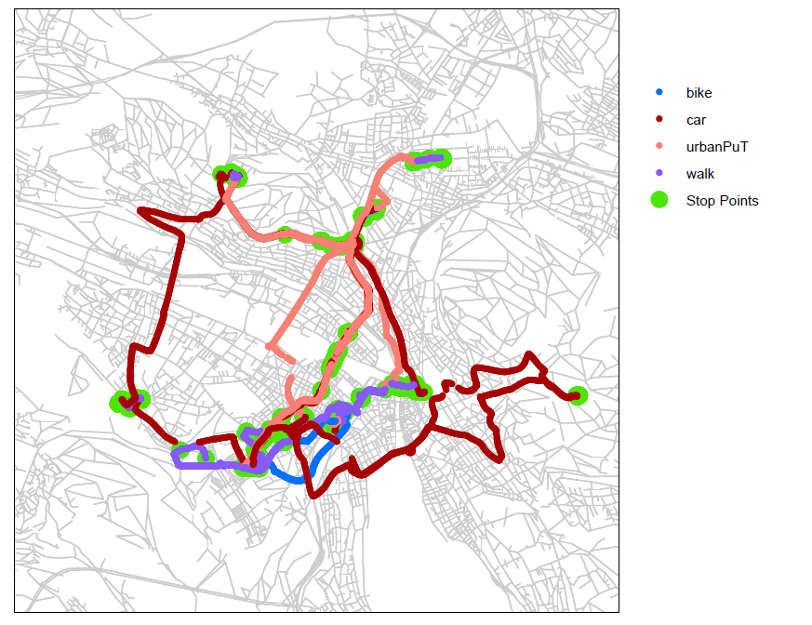
But how?
One week of a Zurich participant

Slide 13
But how?
Dimension | Diary | GSM | GPS
Trips | Directly | Impossible | Post-processing
Completeness | Respondent dependent | No | Yes, but data loss possible
Duration | Rounded to the next 5, 15 min | No | Exactly
Destinations | (Exactly) | Cell tower | Exactly (?)
Purpose | Yes | No | Imputation
Company | Partially | No | No
Routes | Expensively | (Impossible) | Exactly
Recruitment | F(response burden) | (Easy) | F(response burden)
Response period | 1 (-42) days | (Unlimited) | (1-) 7-14 (- ) days

Slide 14
Diaries

Slide 15
Format: Swiss Mikrozensus (MZ) 2010
  Geocoded CATI interview (LINK)
    Person- and household socio-demographics
    Stage-based travel diary
    Routes of car/motorcycle-stages were identified with two way-points (interviewer had map interface)
  Add-on modules for sub-samples (LINK)
    One-day excursions
    Long-distance travel
    Attitudes to transport policy
  Integrated, but independent SC questionnaire (IVT)
    SC mode choice
    SC route and departure time choice

Slide 16
Protocol: MZ 2010
  CATI with multiple calls (no incentives) (72% response rate)
  Households (59’971)
  Persons (62’868)
  Recruitment for the SC: 50% willingness
  Customized SCs for 85% of the recruited within 12 days
  70% response rate for the SC experiments

Slide 17
Route capture: Which ?
 | Slow modes (Walking, cycling) | Motorised travel (car, motorcycle) | Public transport (train, bus, stret car…)
Stages | Roundtrips | All | All
Distance | ≥ 3 km | ≥ 3 km | ≥ 0 km
Detail | Capture of one way-point | Capture of two way-points | Capture of all transfers (end of stages)

Slide 18
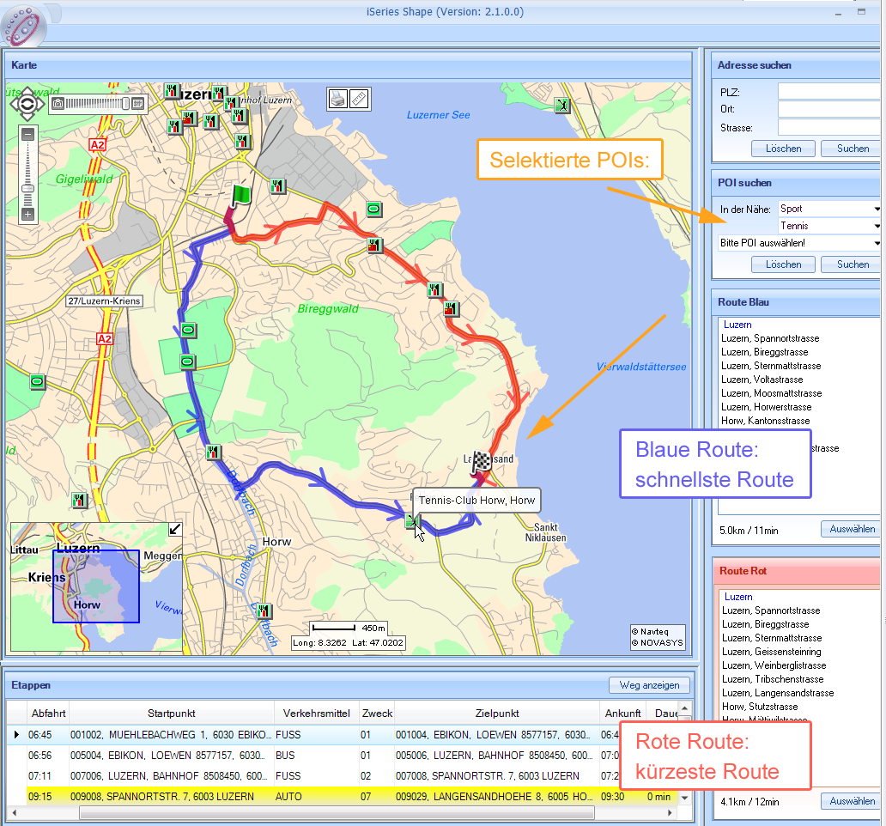
Route capture: Motorised travel
Selection between fastest (blue) and shortest path
Two way points possible (a la Google maps)

Slide 19
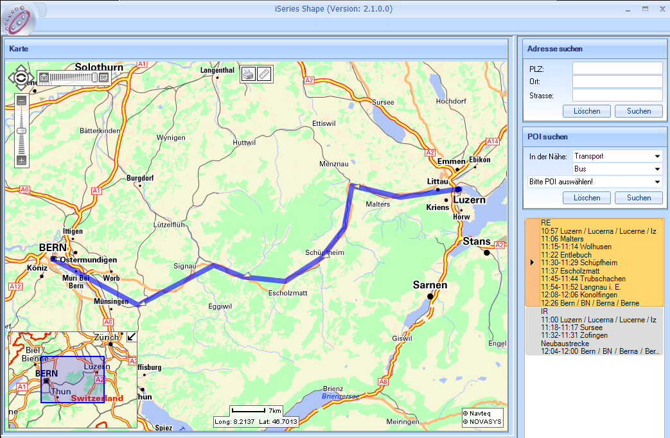
Route capture: Public transport
Valid stops as start and end
Selection based on the national transit schedule
Distance calculation based on the rail network or shortest road path between the stops of the selected service for busses

Slide 20
GPS self-tracing

Slide 21
Some current examples
Captured with | Where | What
GPS logger | Switzerland | Bill board effectiveness study (Sample > 20000)
 | Ireland/Austria | GPS loggers (part of EU-funded Peacox project)
 | Zürich Canton | Transit route choice (IVT, ETH)
Smartphones | Singapore | Capturing activities within and outside buildings (SMART)
 | Bay Area | Capturing trips (Joan Walker and UC Berkeley)

Slide 22
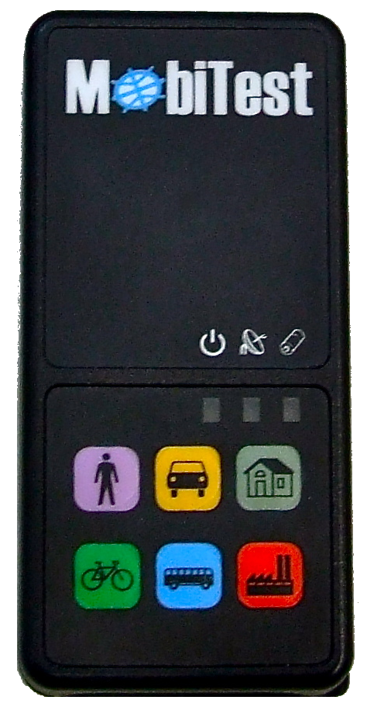
COST and Peacox 7th framework project: GPS based diary at IVT
GPS unit:
  Interval: 1Hz
  3D position
  Date and time
  HPOD and other measures of accuracy
Accelerometer
  Interval 10 Hz
  3D acceleration
Battery
  Multiple days
GSM:
  Savings every 4 hours on SQL database server
Notes:
Price?

Slide 23
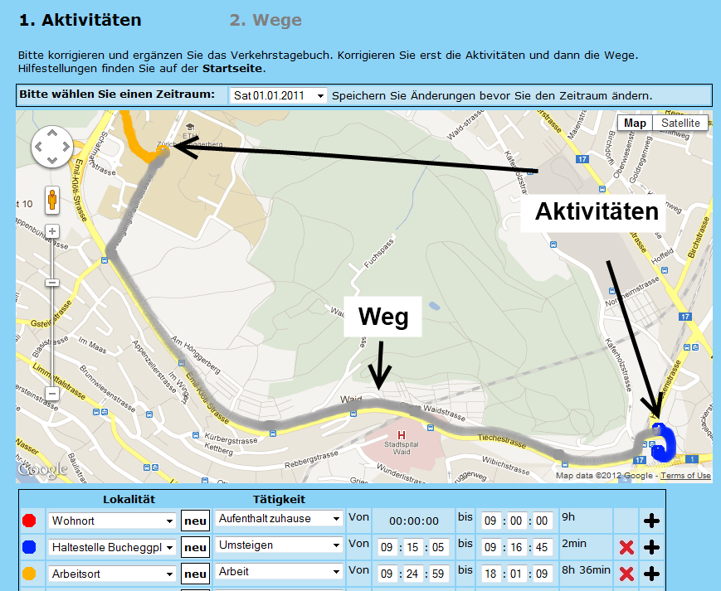
GPS-based prompted recall survey
300 participant for 7 days
Web-survey
Socio-demographics
Attitudes to risk, environment, variety seeking
Checking and correction of the automated processing

Slide 24
Data processing
Filtering and smoothing
Identify stages and stops
Stages
Stops
Mode detection
Purpose imputation
map-matching
Analysis and application

Slide 25
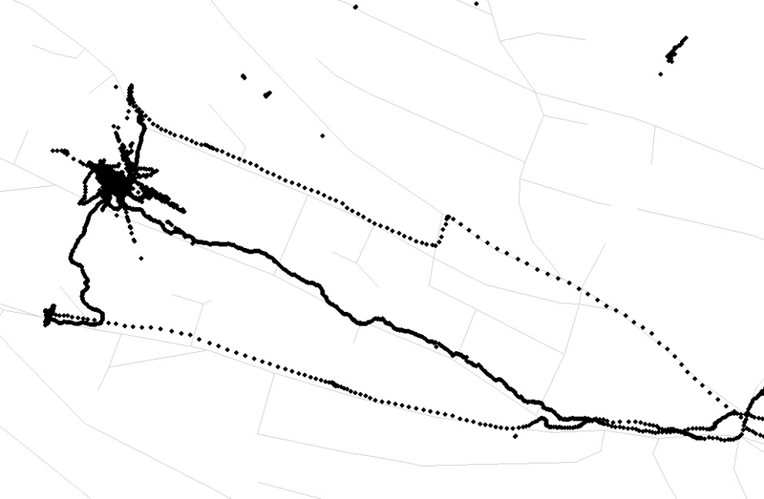
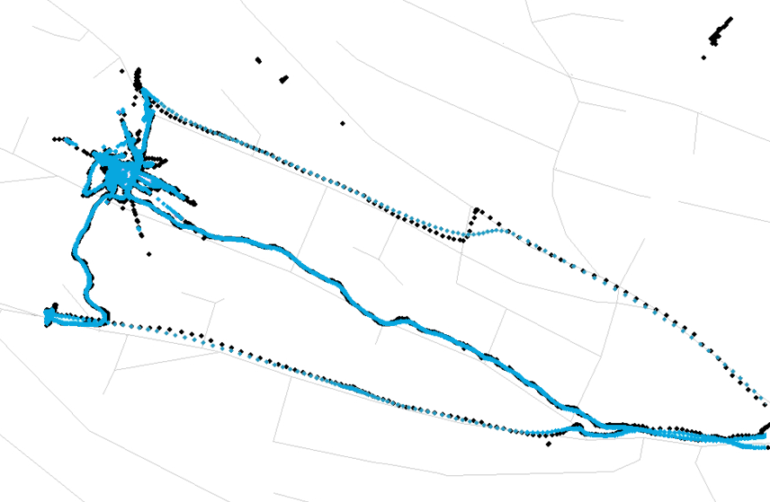
Filtering and smoothing
Filtering
  VDOP > 5
  Unrealistic elevations
  Jumps with v > 50m/s
Smoothing
  Gauss Kernel smoother over the time axis
  Speed as first derivate of the positions
  Raw data are kept

Slide 26
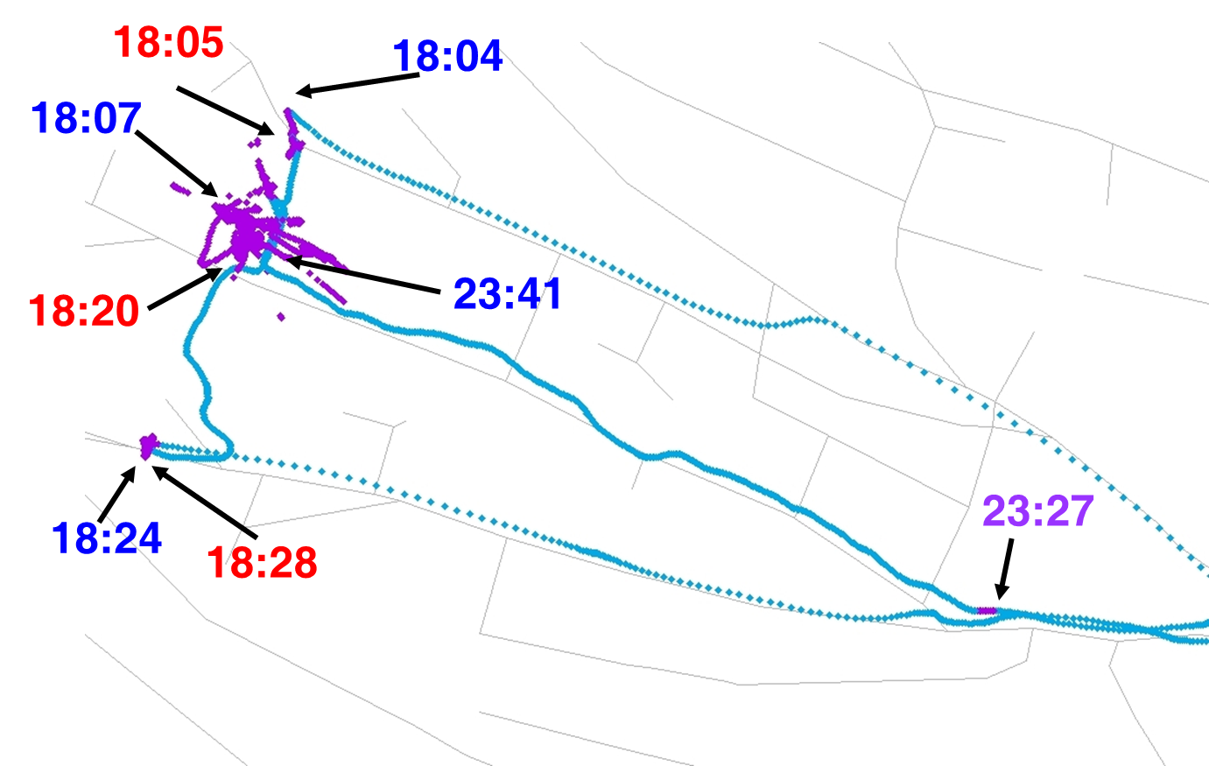
Detection of stages and stops
Clusters of high density
Longer breaks without points
  Accelerometer data
  GPS points
No movement
  V ≈ 0 km/h
  No accelerations
Mode change
  Walk stage as signal
Stops
Stages
Notes:
Umsteigen ist auch eine Aktivität

Slide 27
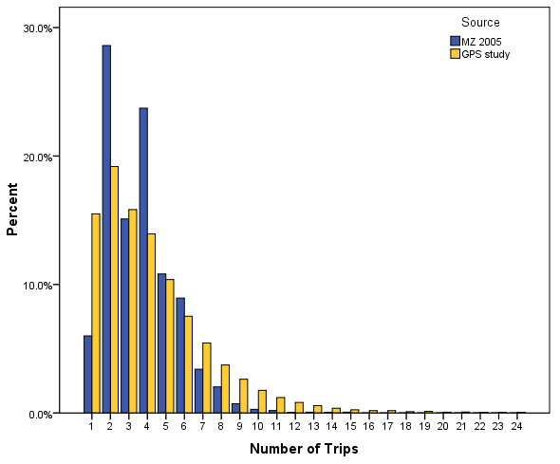
Number of trips/day in comparison with MZ 2005
Source: Schüssler, 2010 (without acceleration data)
27

Slide 28
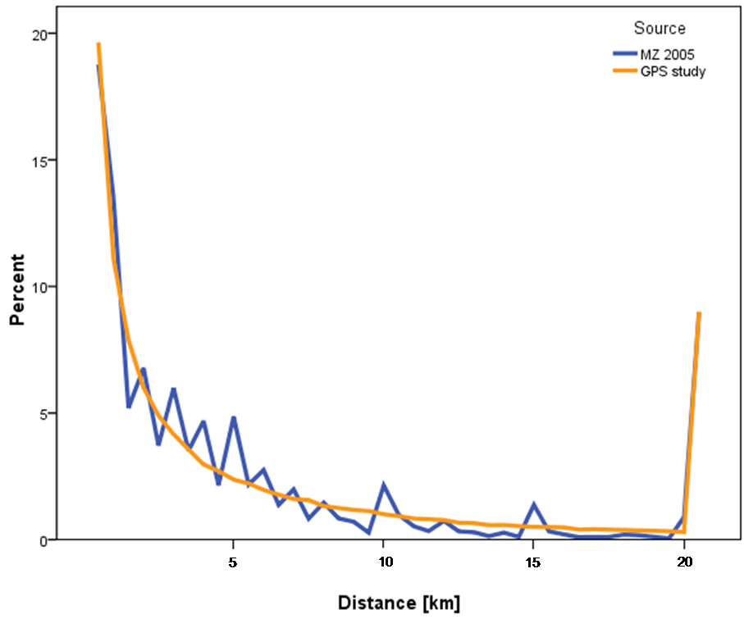
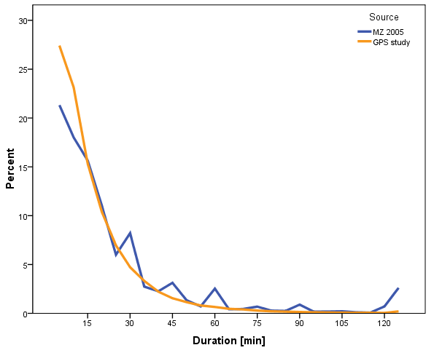
Trip durations and length in comparison with MZ 2005
Source: Schüssler, 2010 (without acceleration data)
Länge [km]
Dauer [min]
Notes:
Rundung Effekt (1 km, 15minuten)

Slide 29
Comparison with MZ 2005
 | ZH | WI | GE | MZ 2005
Number of persons | 2 435 | 1 086 | 1 361 | 2 940
Days per persons | 6.99 | 5.96 | 6.51 | 1
Trips per day | 4.50 | 3.40 | 4.26 | 3.65
Trip lengths [km] | 7.72 | 7.37 | 7.19 | 8.79
Daily trip lengths [km] | 34.74 | 23.20 | 29.25 | 32.13
Trip duration [min] | 15.17 | 13.71 | 15.05 | 26.21
Stages per day | 1.40 | 1.31 | 1.47 | 1.68
Source: Schüssler, 2010 (without acceleration data)

Slide 30
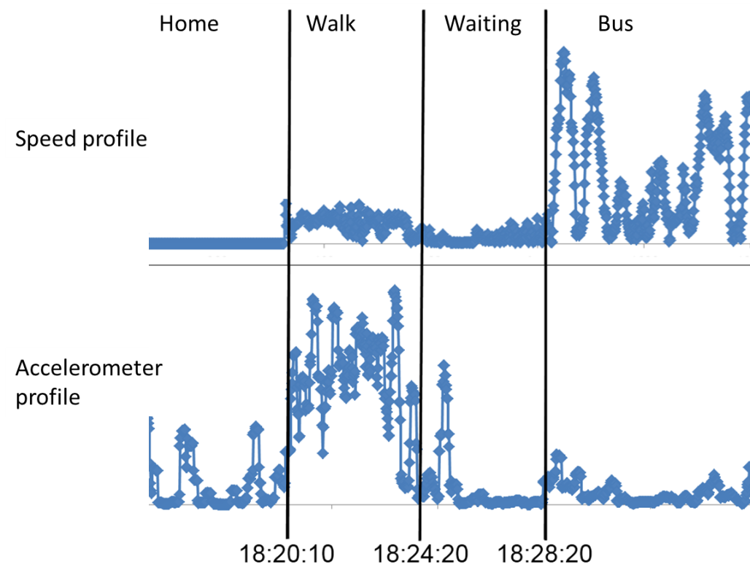
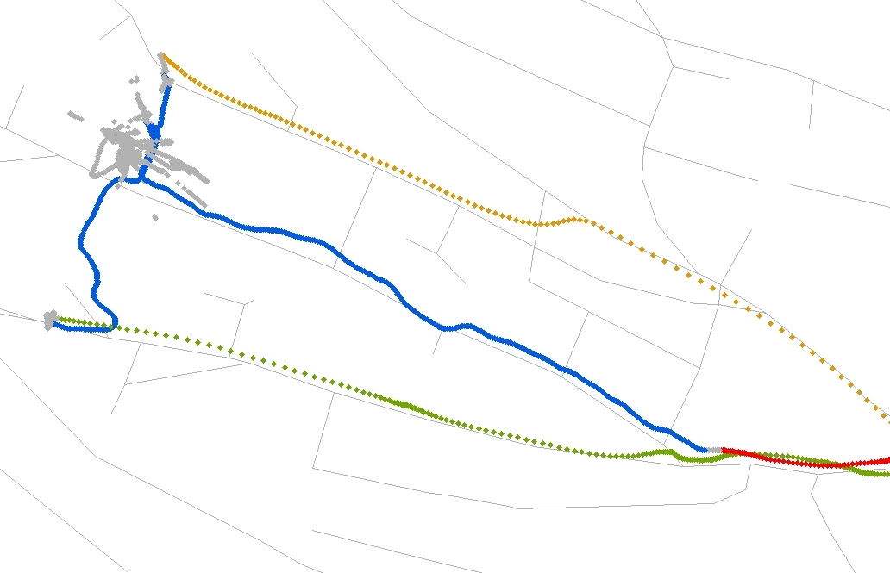


Mode detection
Notes:
Fuzzy Logic basierend auf
Geschwindigkeit (berechnet aus den GPS Punkten)
Beschleunigung (aufgezeichnet mit dem Beschleunigungsmesser)
Nähe des Etappenendes zu einer ÖV-Haltestelle
Erweiterungen in Arbeit:
Einbezug des Besitzes von Mobilitätswerkzeugen
(Auto, ÖV-Abo)
Plausibilisierung der Verkehrsmittelketten

Slide 31
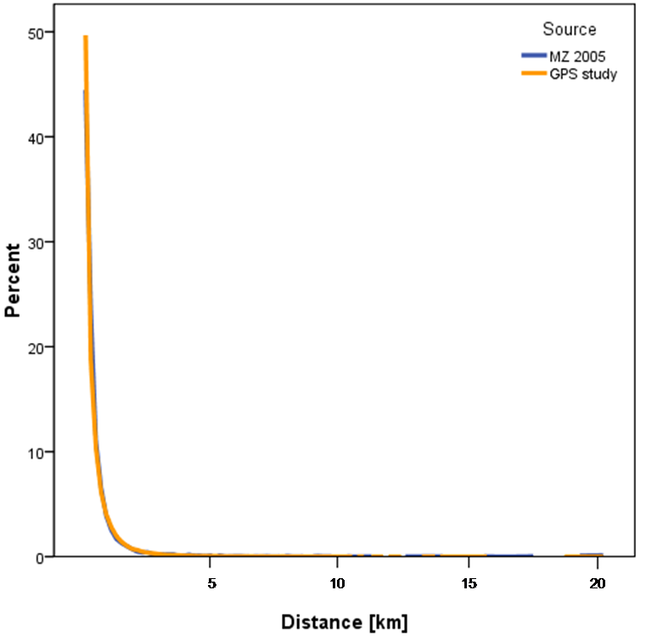
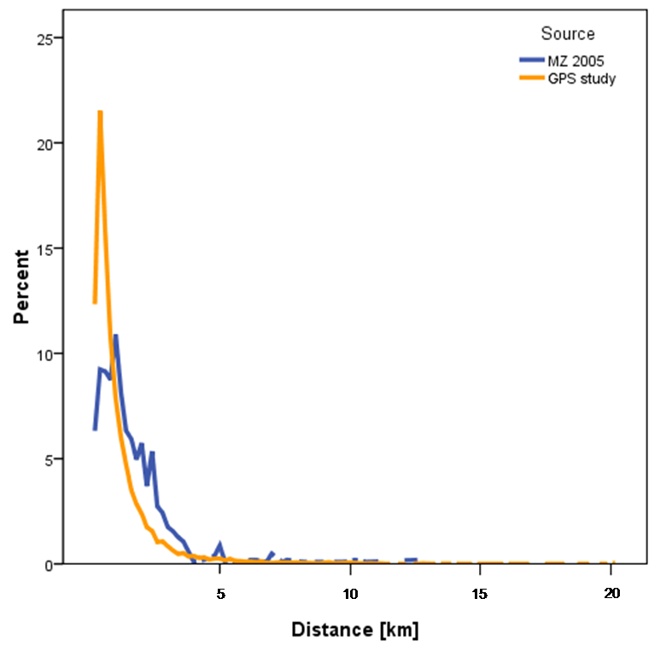
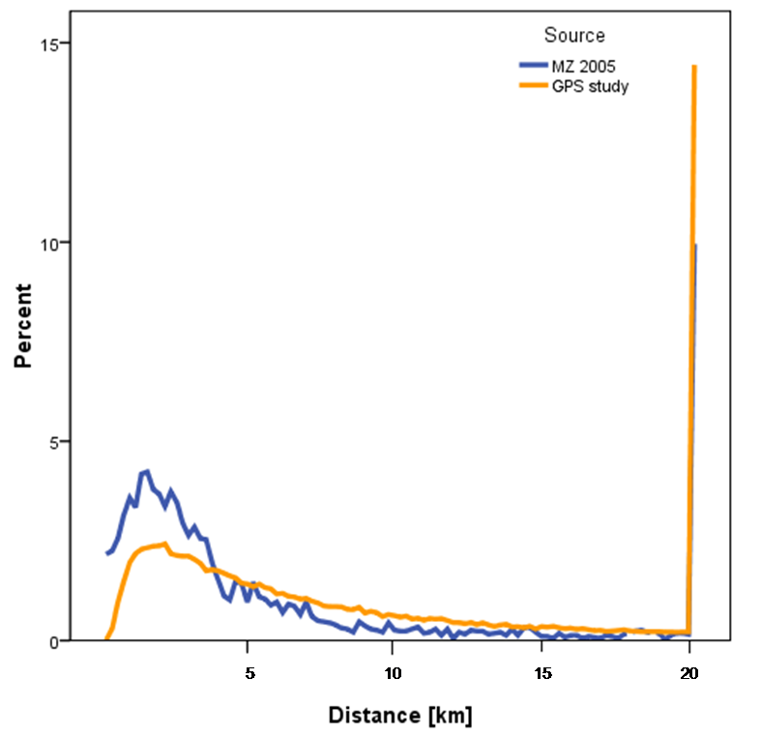
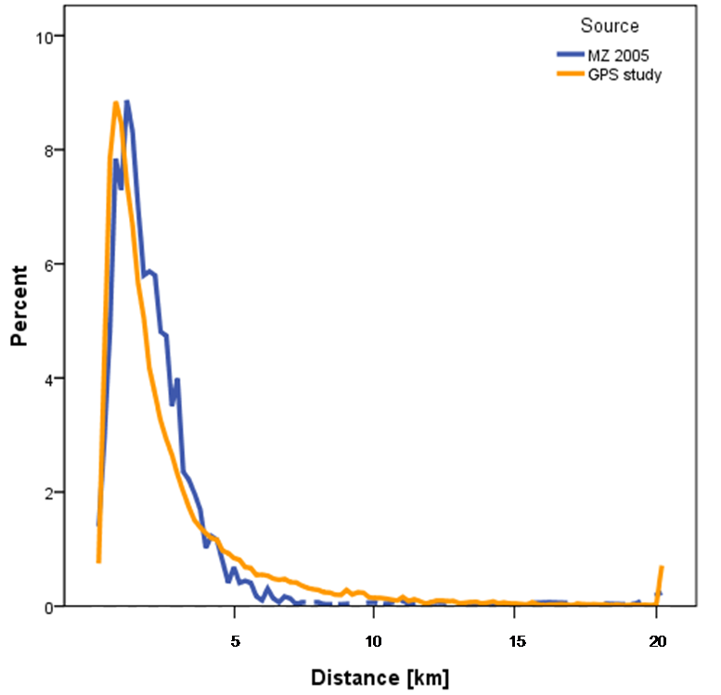
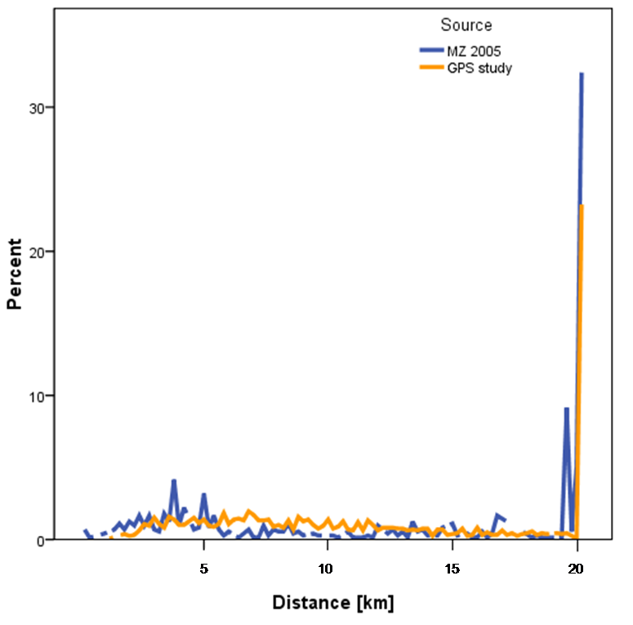
Trip length by mode in comparison with MZ 2005
Walk
Bycicle
Car
Source: Schüssler, 2010 (without acceleration data)
Public Transit - City
Train

Slide 32
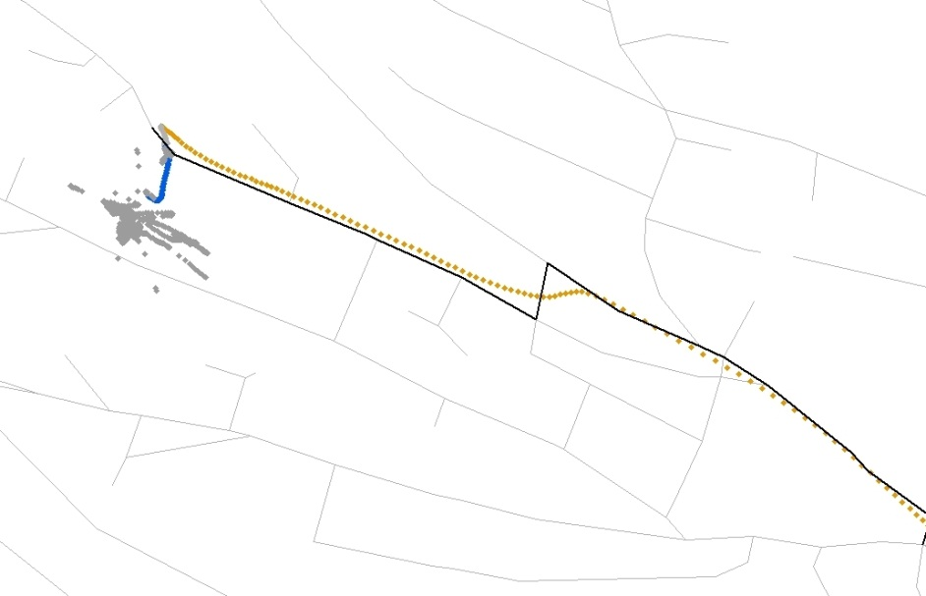
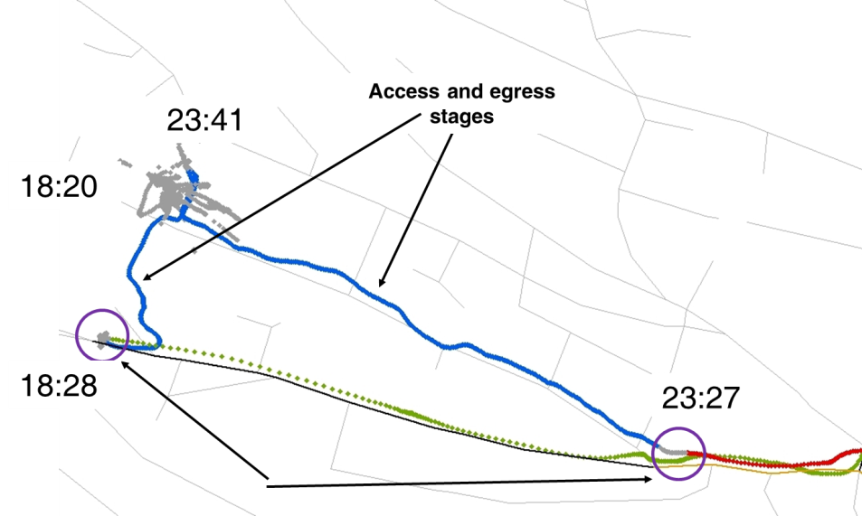
Map matching
Car and bike stages
Selection from a set of possible routes
At nodes all possible on-going links become new candidate routes (branches)
If the tree has enough branches, it is pruned based on their total errors
Each candidate branch is assessed by
Squared error between GPS and path
Deviation between GPS speed and posted speeds
Transit-stages
Route identified as for cars
Line identified by time table

Slide 33
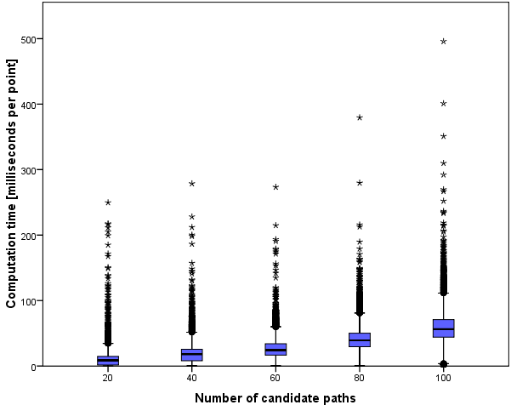
Map-Matching: Number of branches against computing times
Source: Schüssler, 2010 (without acceleration data)
33

Slide 34
Research needs: GPS post processing
34
  Test dataset with true values
  Further integration between map-matching and mode detection
  Better imputation of the movement during signal loss
  More and better purpose imputation (POI – data base; land use data; frequency over multiple days)

Slide 35
What now ? Cost of GPS/Smartphone studies as a function
35
  Rate of usable addresses
  Recruitment rate
  Response rate
  Rate of usable returns
  Correlation between household members
  Correlation between days
  Correlation between tours of a day
  Correlation between trips of tour
  Number of waves with the GPS loggers
  Rate of loss of the GPS loggers

Slide 36
What now ?
 | Diaries | GPS-self tracing
Advantages | All variables Social contacts | All movements (but data loss) Exact times, routes, locations Longer observation periods
Dis-advantages | ≈15% under reporting of trips Rounded times Approximate routes only Decreasing response rates / expensive response | Post-processing and imputation (Effort of the post-processing) Unknown response rates (Costs of the units and their distribution/collection)

Slide 37
Questions?
www.ivt.ethz.ch
www.matsim.org
www.futurecities.ethz.ch

Slide 38
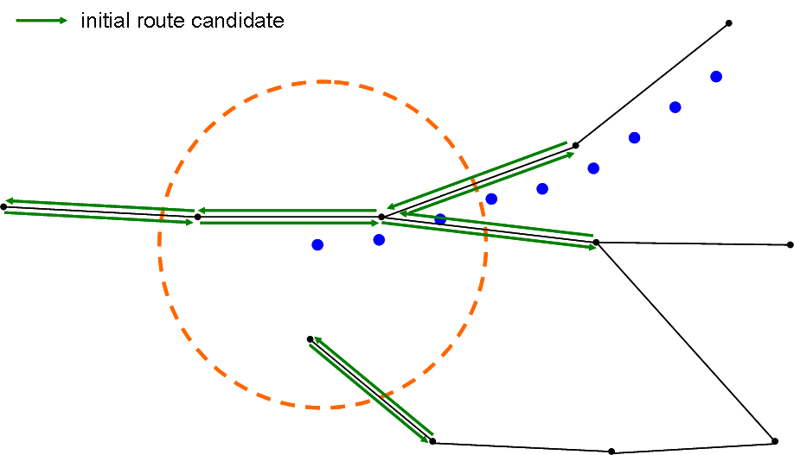
Map-Matching: First branches
Source: Schüssler, 2010 (without acceleration data)
38

