Slide 1
Recognizing personalized flexible activity patterns
Sergio A. Ordonez M.
July 2015

Slide 2
Recognizing personalized flexible activity patterns
Sergio A. Ordonez M.
July 2015

Slide 3
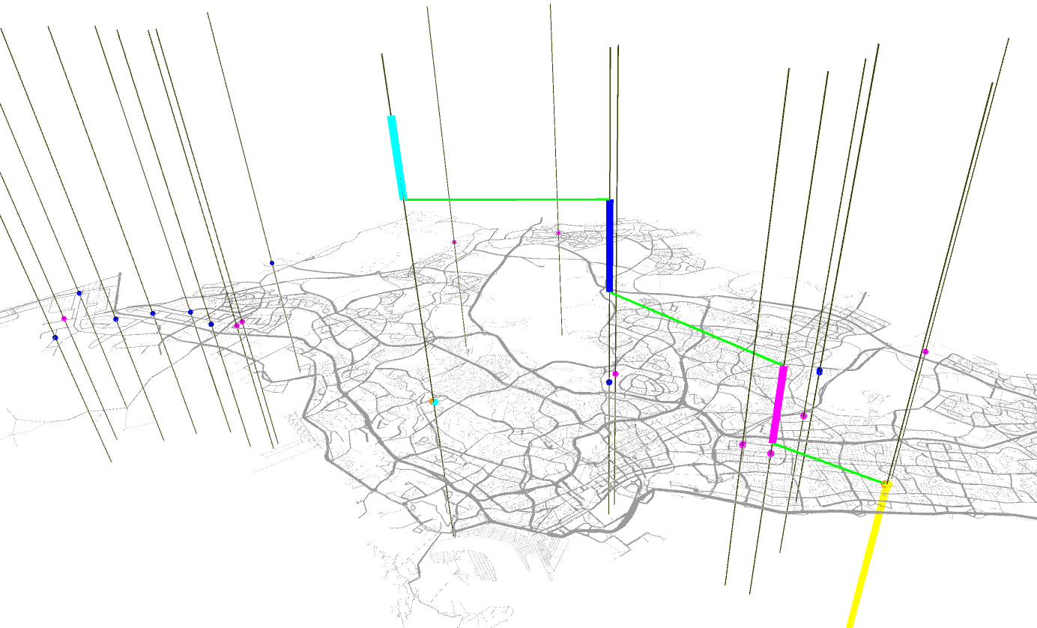
Context: Multi-activity scheduling, flexible activities
0:00
6:00
9:00
18:00
23:00
A
B
Home
time
Work
Eat
y
Work
Car
PT
x
Walk

Slide 4
Mental map: Set of known places & Activity agenda

Slide 5
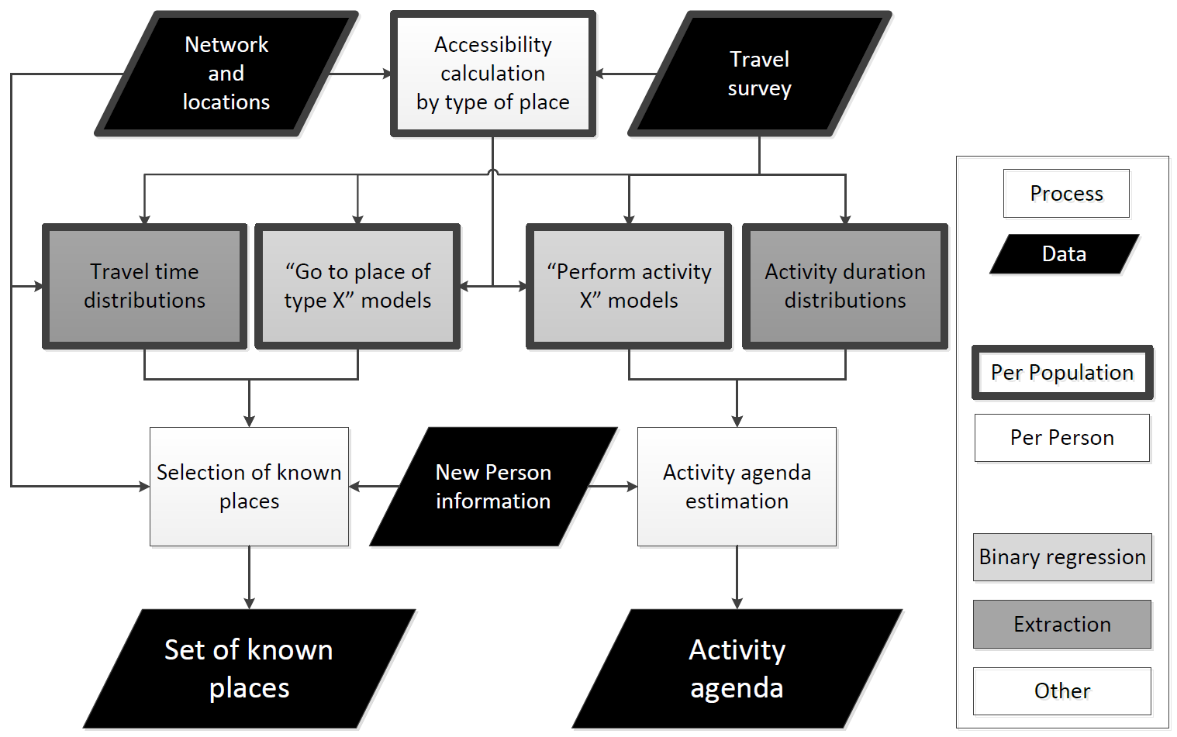
Overview
Mental
Map
Notes:
Problems:
Representation of waiting queues

Slide 6
Set of known places

Slide 7
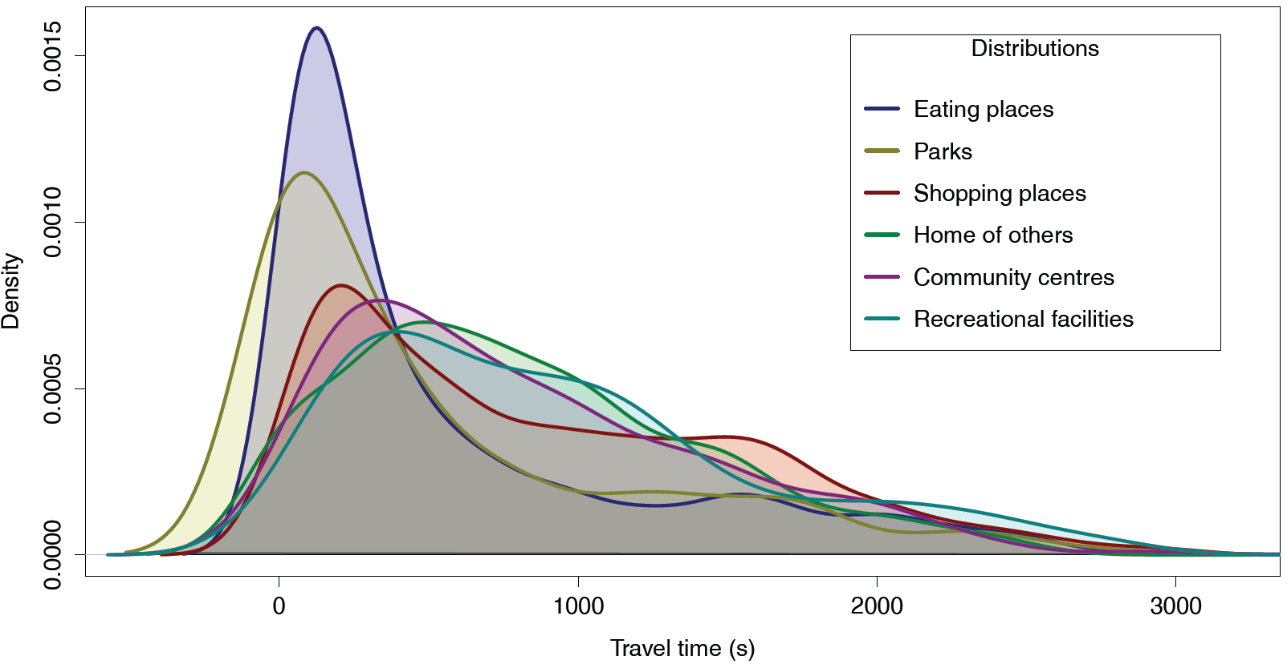
Travel time distributions

Slide 8
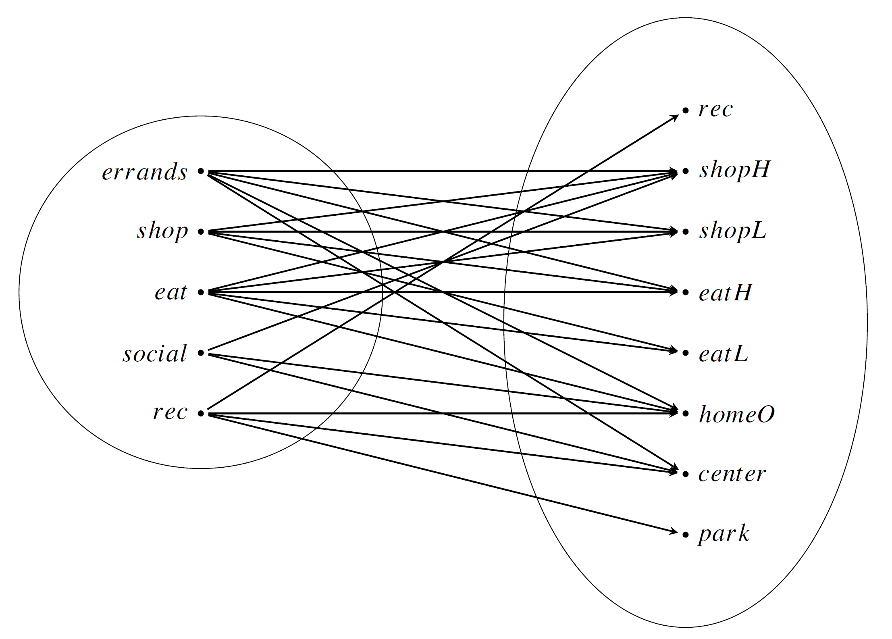
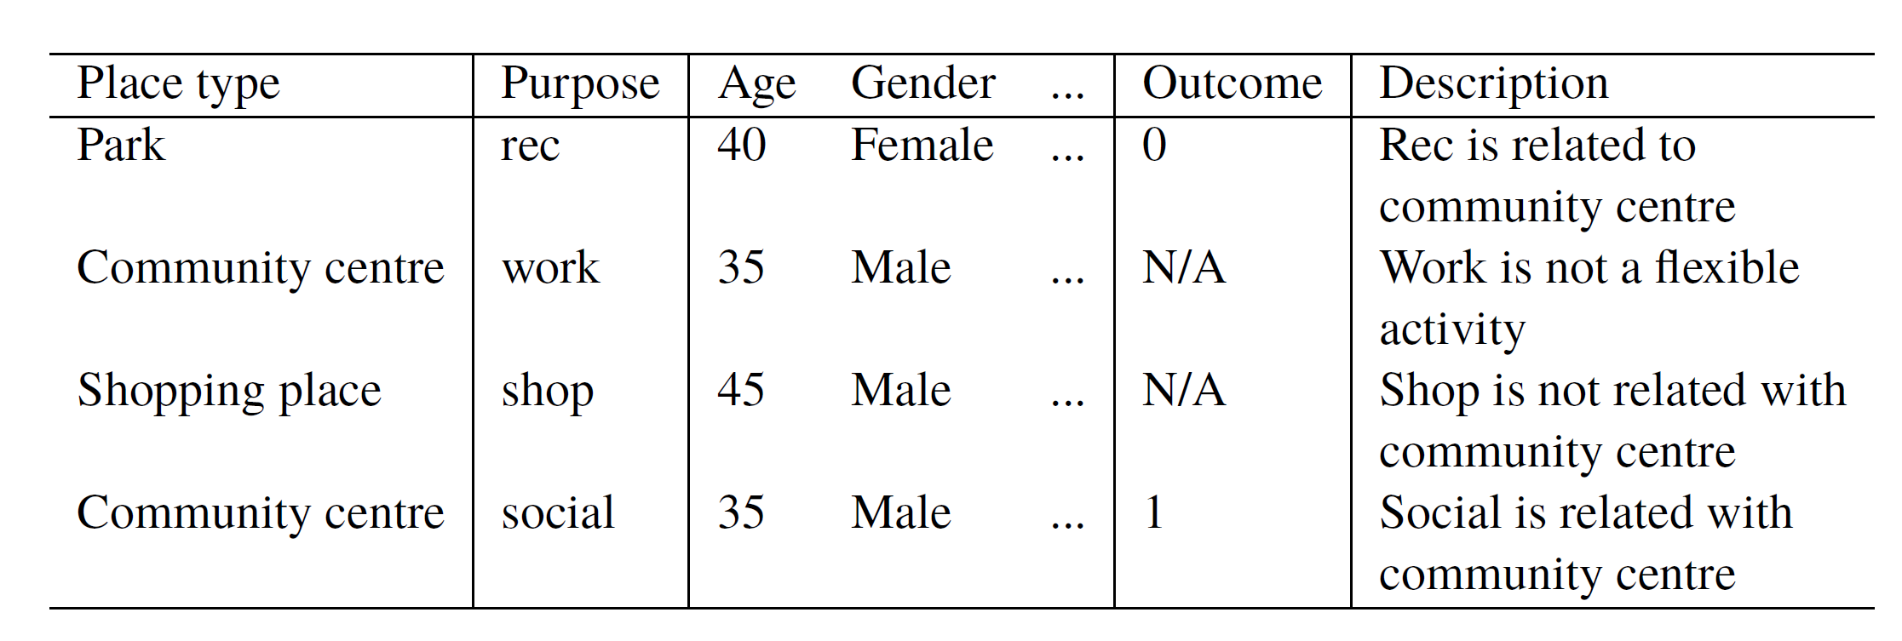
“Go to place of type X” models

Slide 9
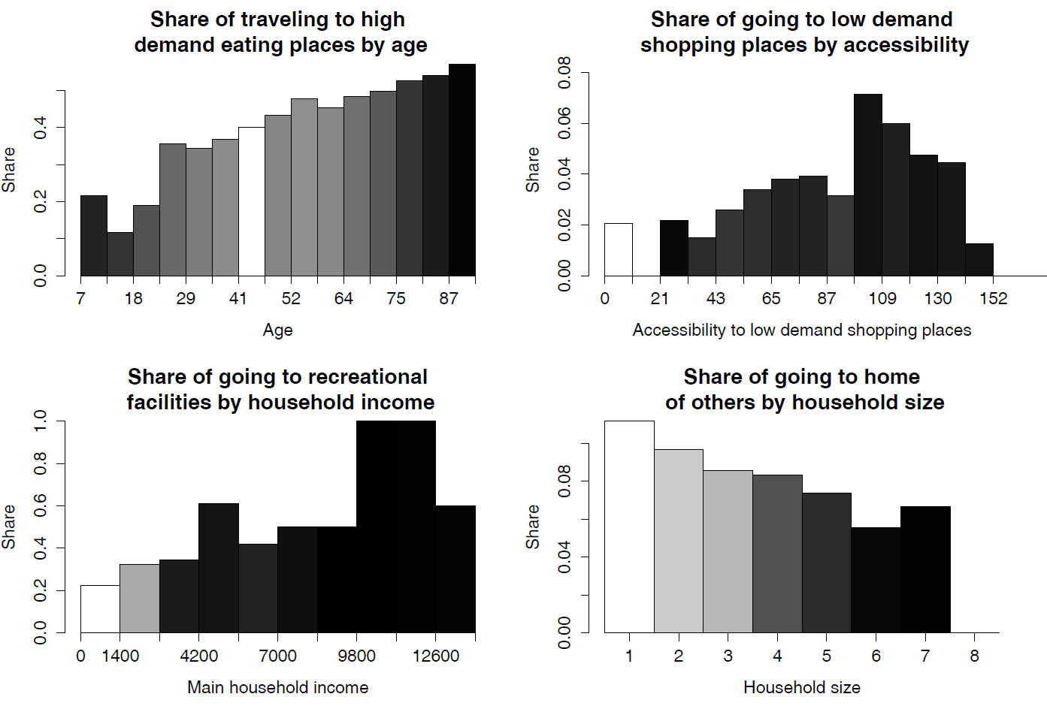
“Go to place of type X” models

Slide 10
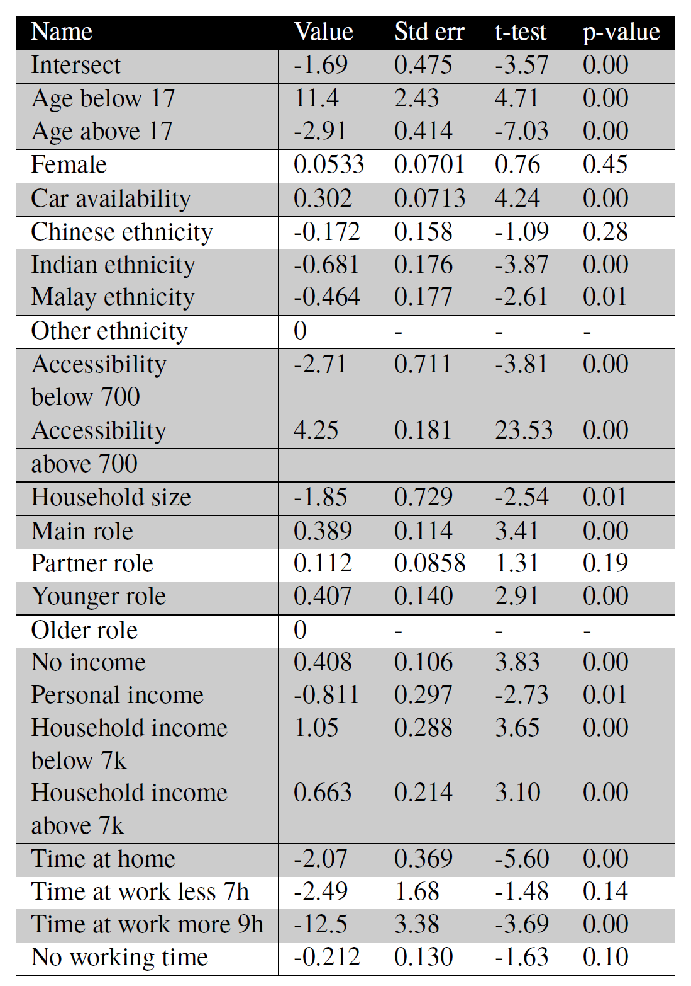
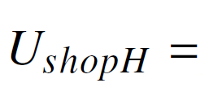
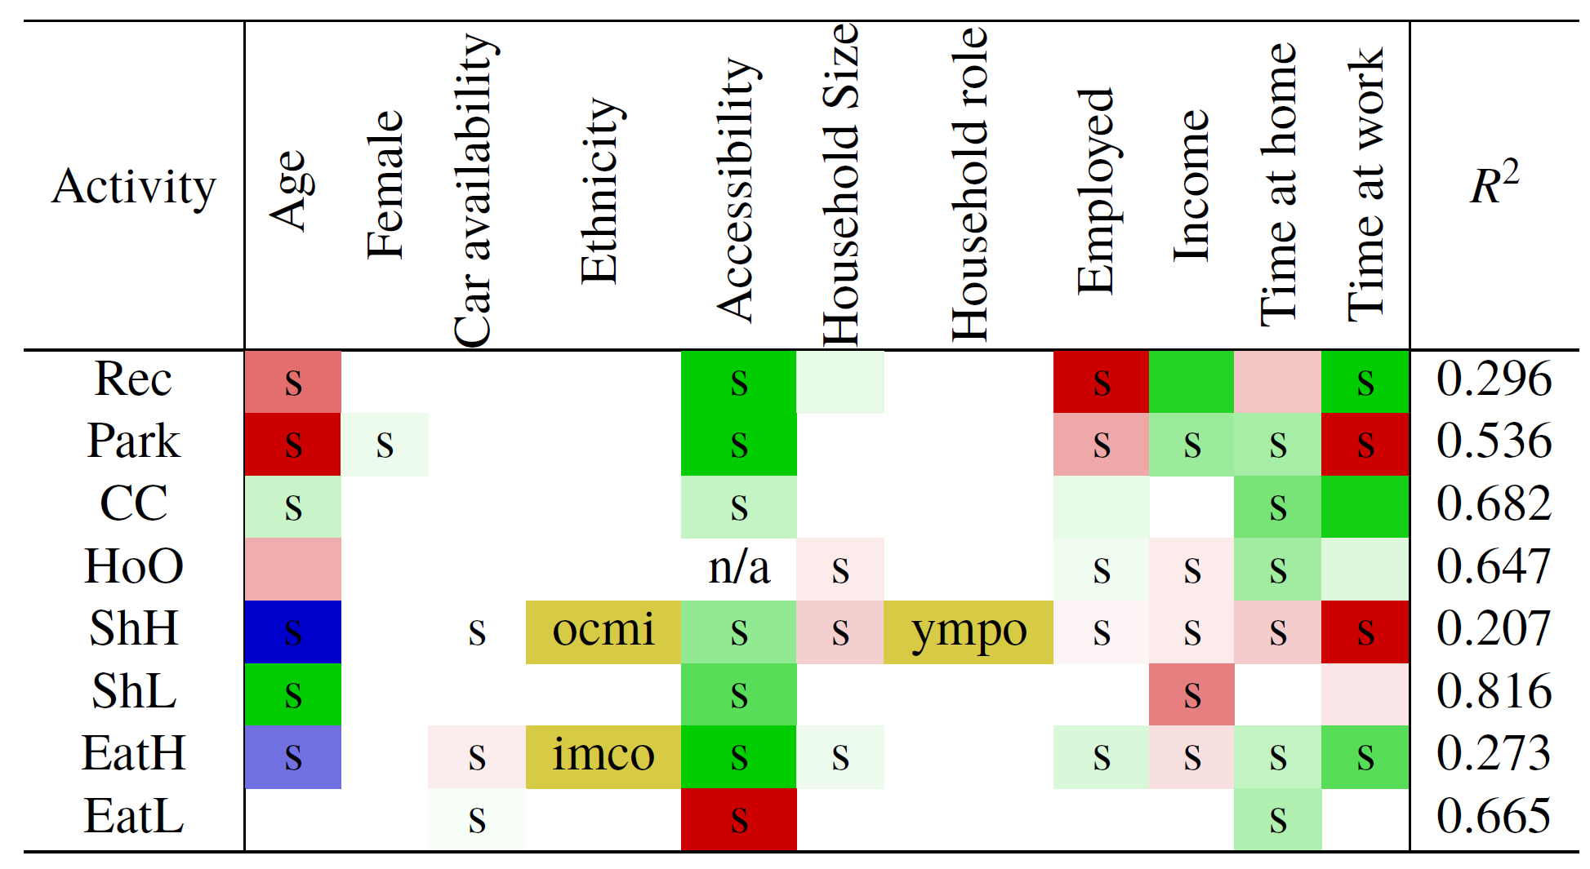
“Go to place of type X” models
“Go to a shopping place” model summary

Slide 11
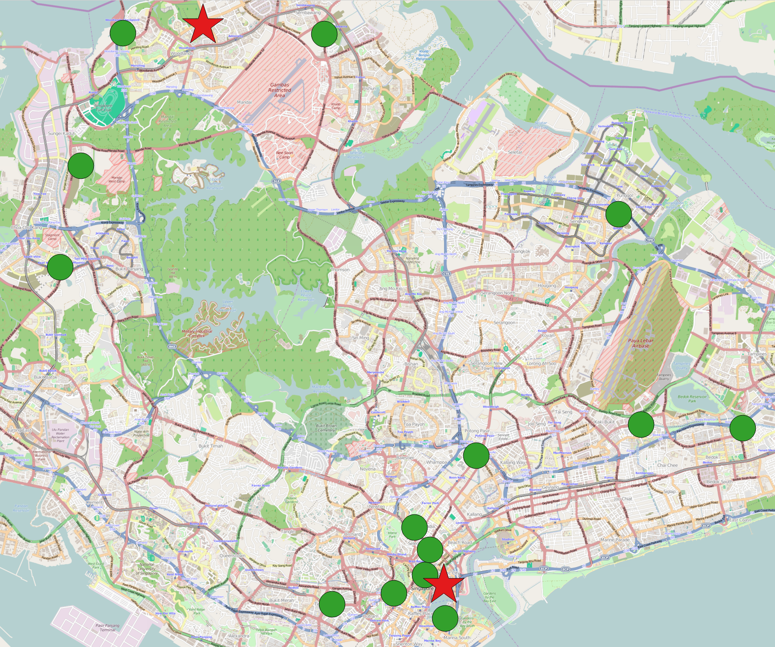
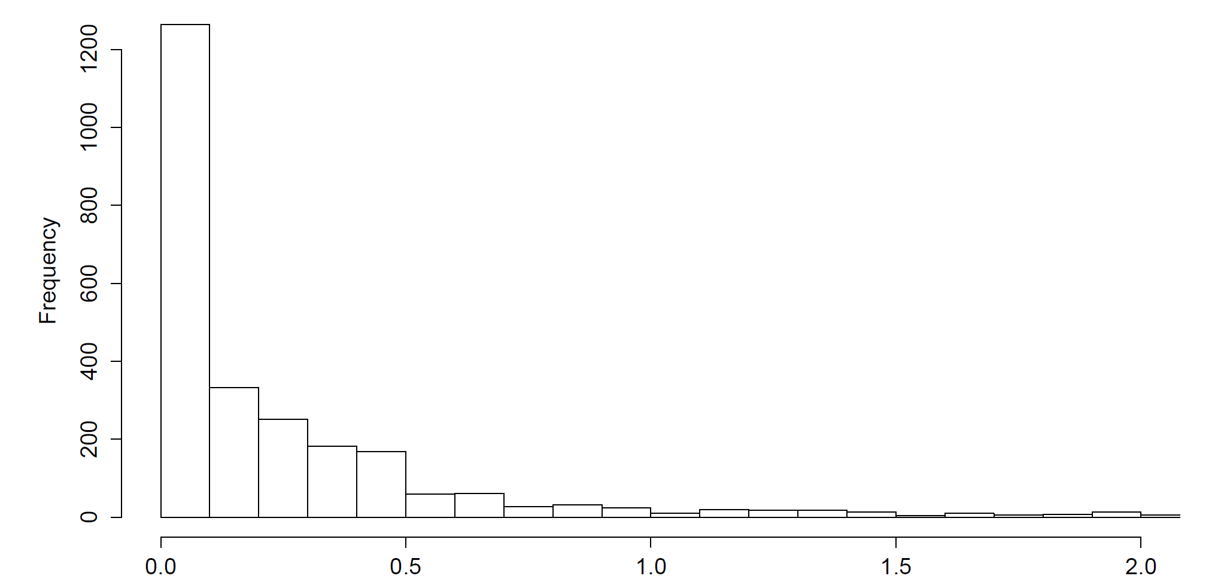
Set of known places selection
Step one: Selection by type
Step two: Selection by travel time to primary locations

Slide 12
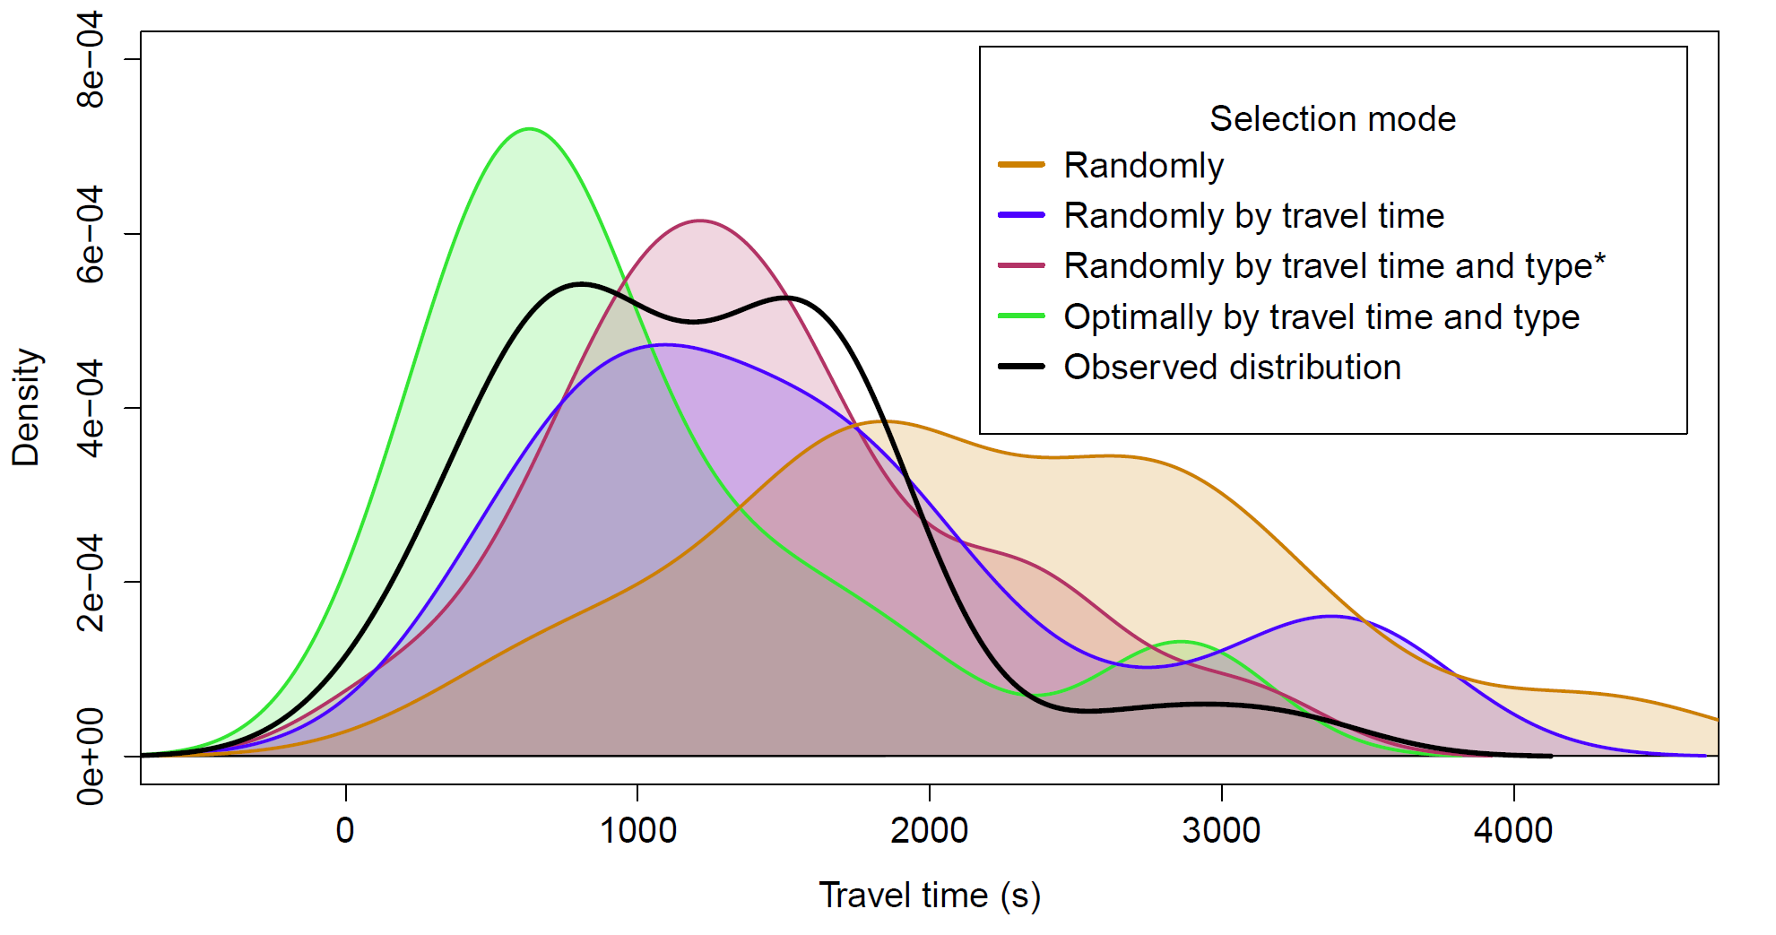
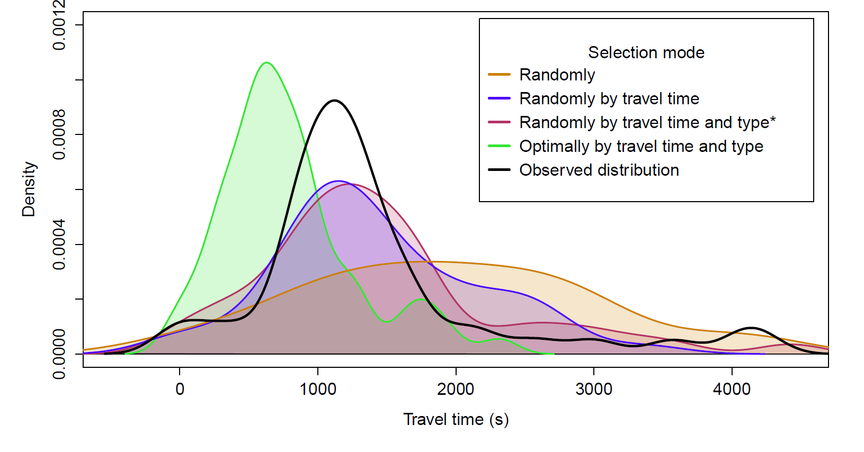
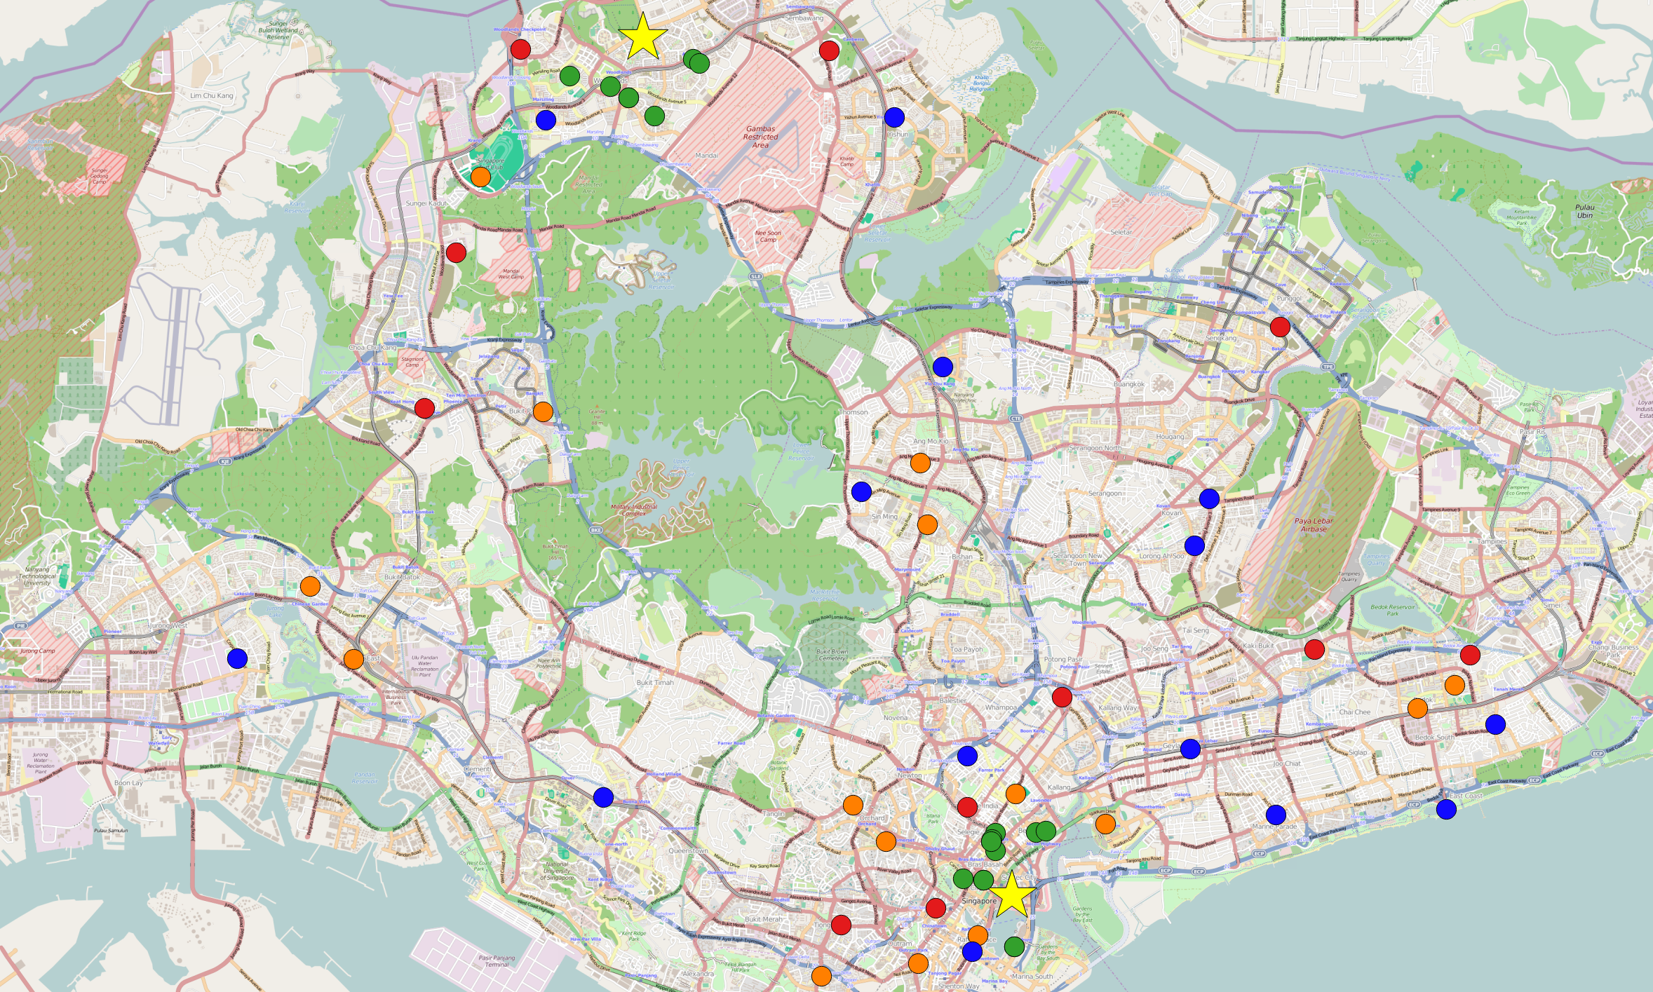
Results: Travel times
eat
shop

Slide 13
Activity agenda estimation
Notes:
Problems:
Representation of waiting queues

Slide 14
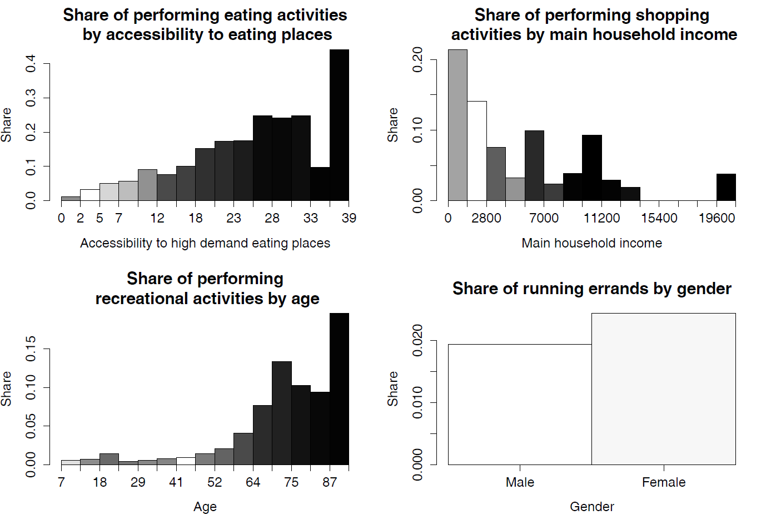
“Perform activity X” models

Slide 15
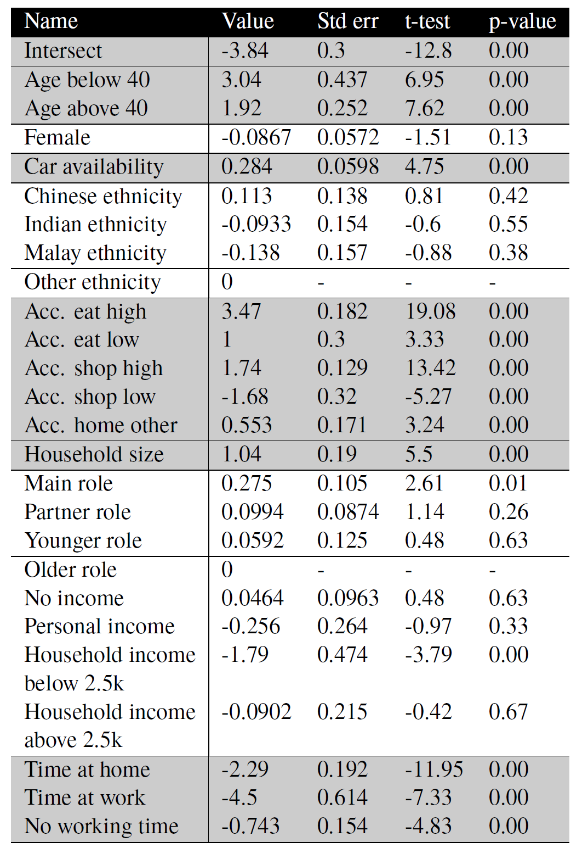
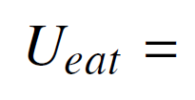
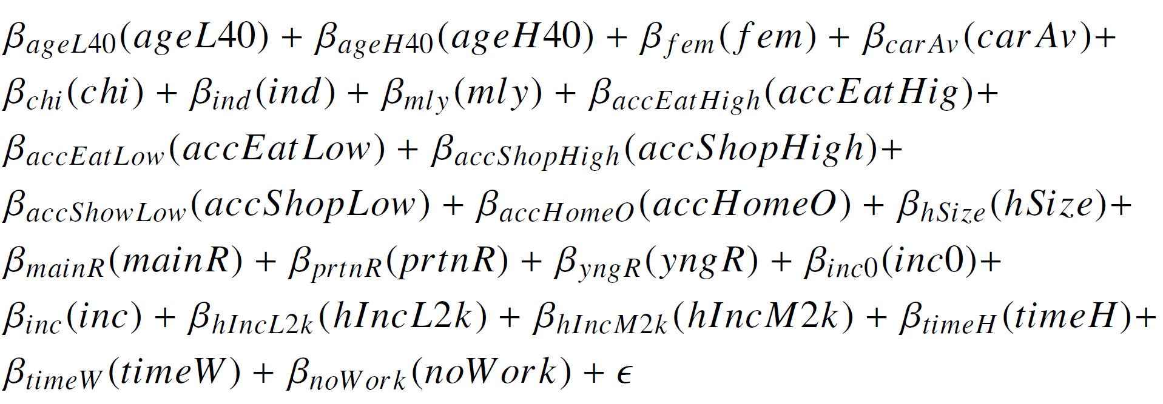
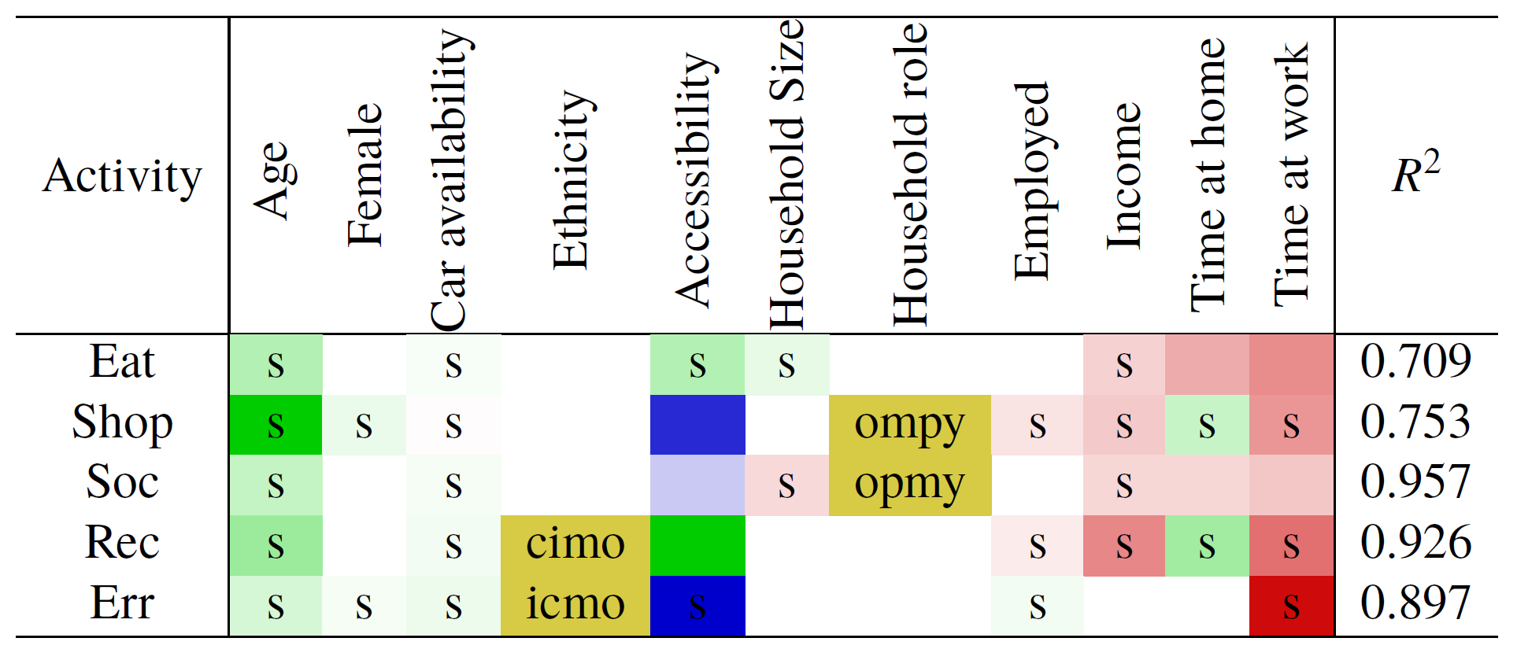
“Perform activity X” models
“Go to eat” model summary

Slide 16
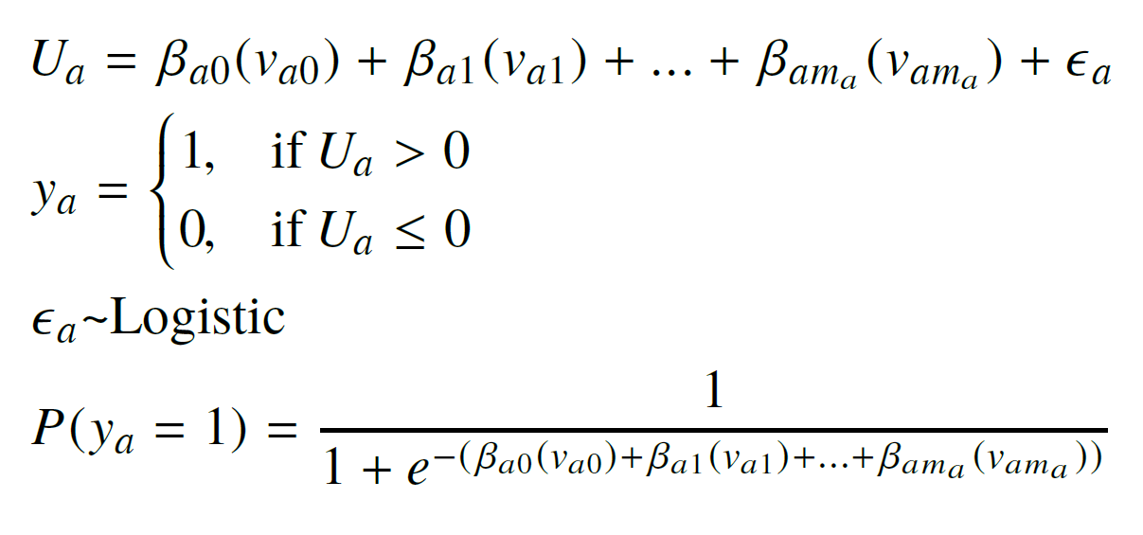
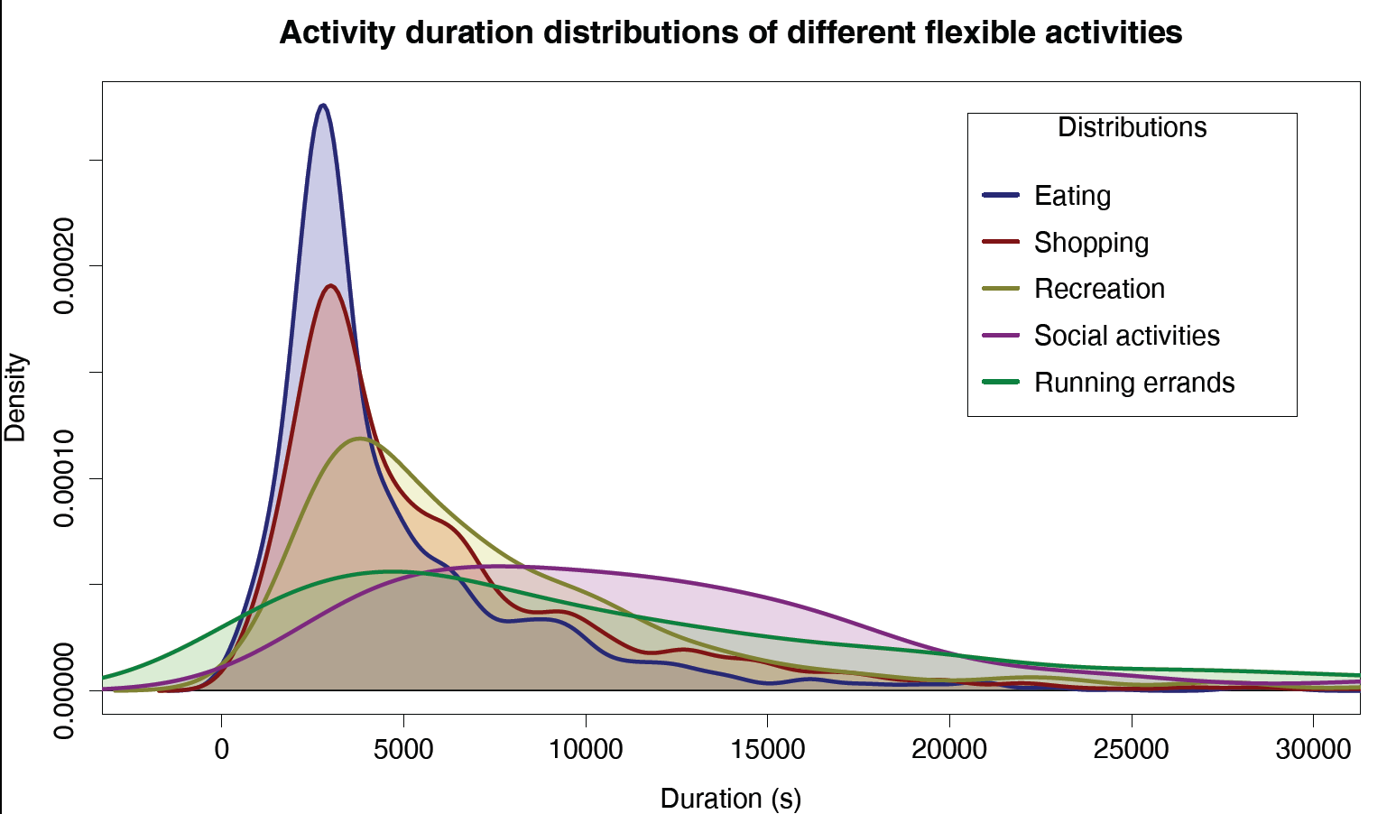
Activity agenda estimation
Activity type probability
Activity durations

Slide 17
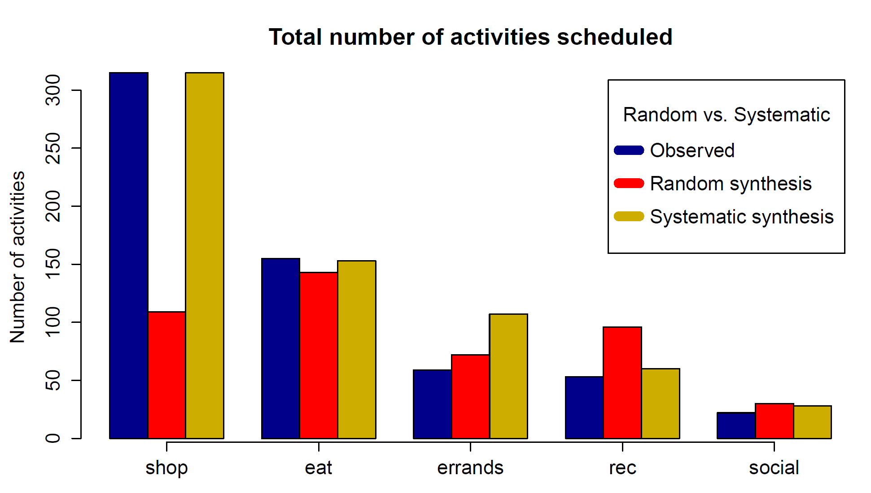
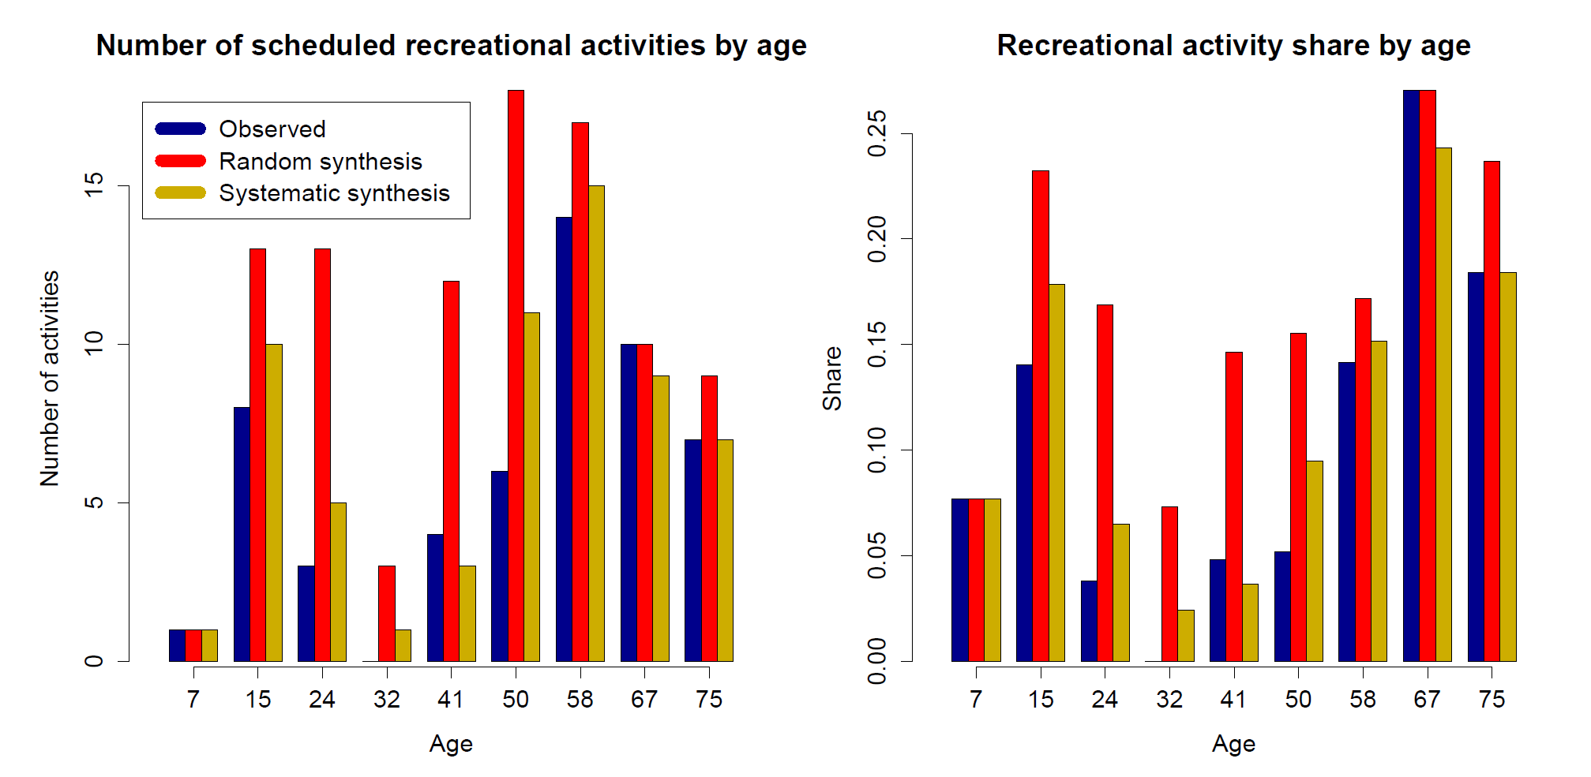
Results: Flexible activity types

Slide 18
Conclusions and future work
In the context of personalized flexible activity scheduling the concept of a mental map was studied
Activity agendas and set of known places were synthetized for a 10% test sample from a travel survey conducted in Singapore
Socio-demographic characteristics and geographic information of primary locations were included for the mental maps generation
Results show the method can reproduce observed travel time distributions from primary locations to flexible activity locations
When scheduling flexible activities using the proposed mental maps, the number of flexible activities by type and by significant socio-demographic variables was reproduced.
The duration of the flexible activities should also be derived from socio-demographics and geographic information
Frequency of activities should also be included in the model for longer periods of time

Slide 19
Acknowledgements
The author would like to thank the following Singaporean Authorities for providing access to data and valuable review:
Land Transport Authority
Urban Redevelopment Authority
Singapore Land Authority (SLA Digitised Land Information)
Financial support comes from the National Research Foundation (NRF) of Singapore and ETH Zurich research fund.

